Slide 1
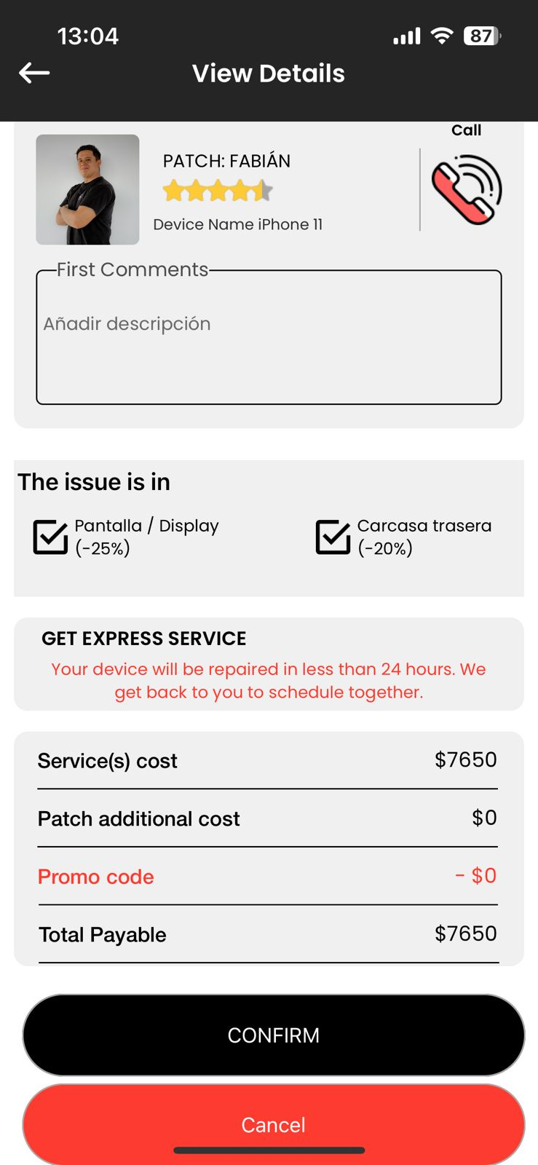
Modifications of the service requests, both of the selected services to be performed, as well as the total payment amount. This must be able to be modified by the technician and must be reflected in the client's App and the final summary of the service.
Cases:
If the client make a mistake on the initial request. The technician must be able to change it including the model, services and the cost.
The technician must be able to add an “Additional cost” with any concept showing the concept of this extra on payment resume. Always with the client approve.
These elements must be modifiable. Modifying elements such as the device, or the services to be paid will also modify the final total amount. The final total amount should subtract any payments that have been made previously, such as the down payment. The warranty information should also be updated.
Device model
Services
Patch Additional cost

Slide 2
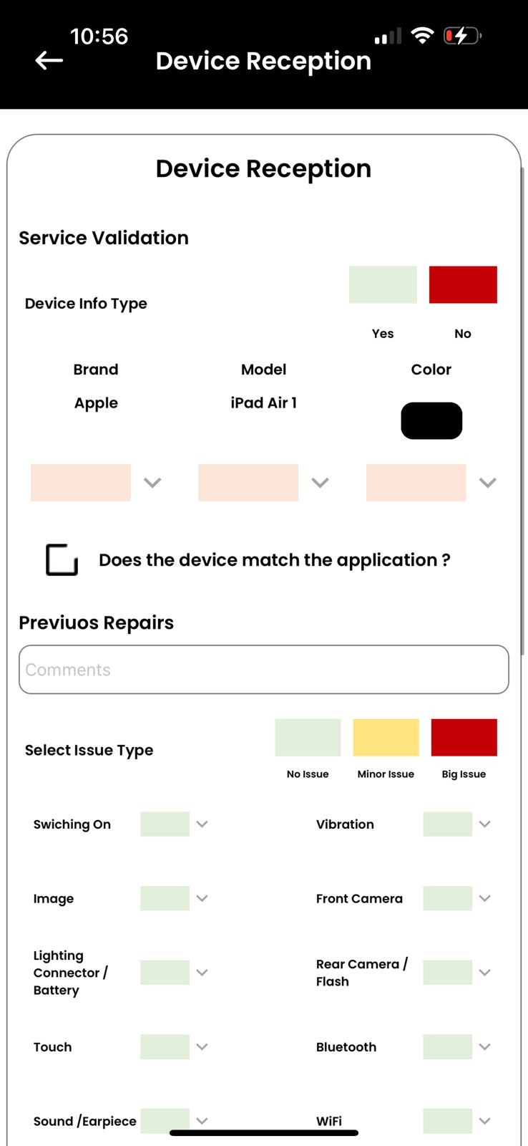

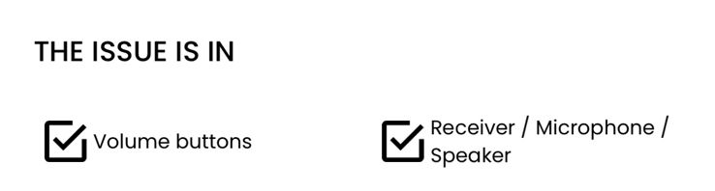
Here the technician can change the equipment information. Both the brand and the model and even the color. This is in case the customer has the wrong model. The change will be reflected in the total budget.
Here the technician can change the requested services according to the model and equipment that may or may not have been modified before.

Slide 3
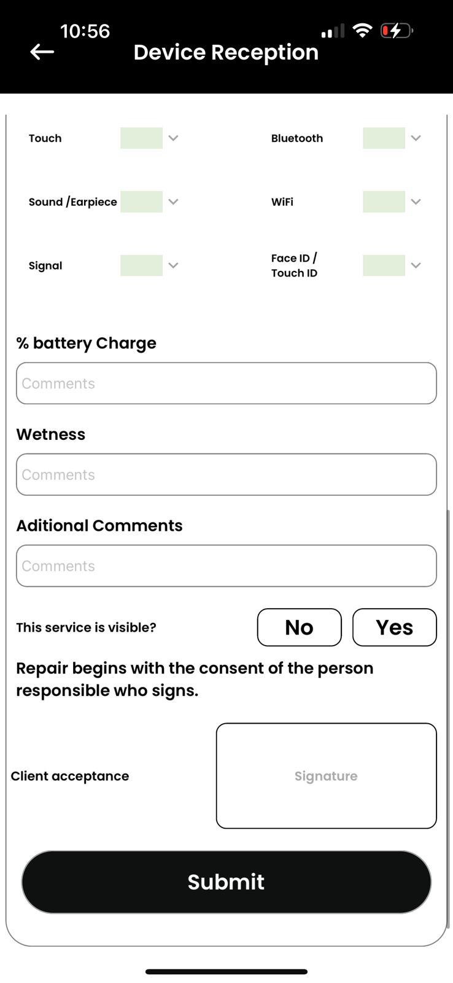
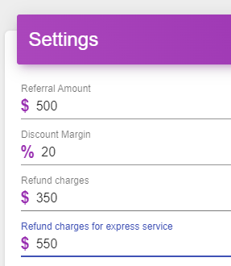
Here will appear the difference between the initial cost vs. the cost of model adjustments, equipment and requested services by the technician. The amount may appear as an increase, cero or decrease
a) +$999,999.99
b) $0
c) -$999,999.00
Here the technician can include any additional costs to be included for the above changes and adjustments. Always indicating the amount and the concept.This can be monitored from the admin panel.
Adjustment in service cost
+$1,200.00
Additional Cost: $99.00
Concept: Spare Parts delivery
The customer must accept the adjustments made by the Patch by signing at the end. In case of disagreement, the technician will select that the service is not viable and will be terminated, with the process of refunding the first payment, minus the termination fee.
TOTAL SERVICE COST
$4,299.00
When the customer signs, the process can proceed as normal.

Slide 4
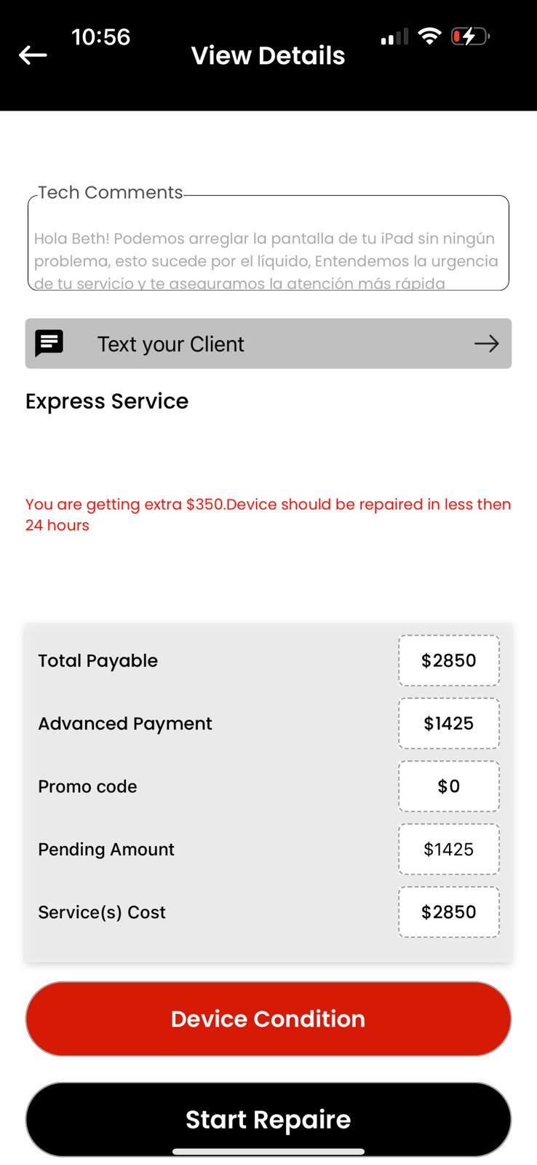
With the customer's acceptance, the new settings should appear in the service summary, both in the user app and in the technician app, considering the brand, equipment, color, services requested, etc. In case there is a decrease in the total cost of the service, it should be reflected, and in the second payment, the new amount to be paid will appear. The first payment is not subject to change.It will also be reflected in the service guarantee.

Slide 5
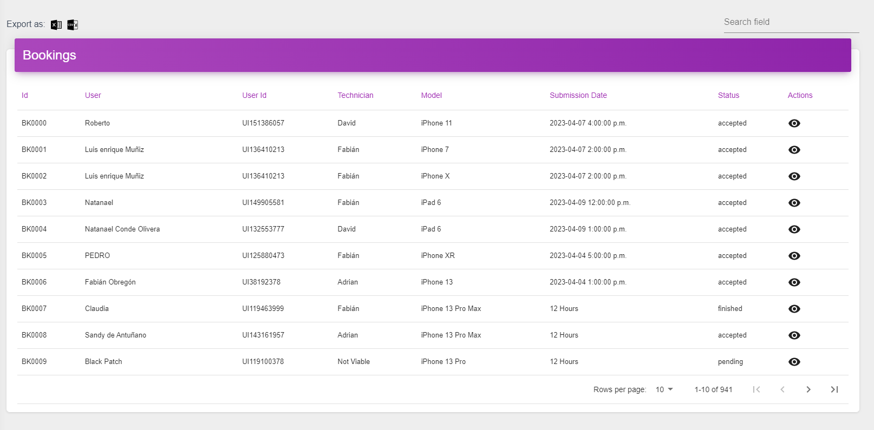
3. That the services that come to expire that were not confirmed or accepted by the technicians, to reactivate and resend to the technicians. This we must be able to define it in the admin panel. Cancel expired services or without confirmation, (notifying the client that the service is canceled) This we must be able to define in the admin panel.
We need an option to reactivate the service when no patch has accepted the service. To be able to define which technician will be sent to take care of it. We also need to be able to cancel services that are too old. They should not disappear from the history. They should be moved in the technician's App from active services to service history.
If the service is cancelled, the customer should receive the notification "Your request was cancelled due to inactivity. You can reapply for your service when you are ready."

Slide 6
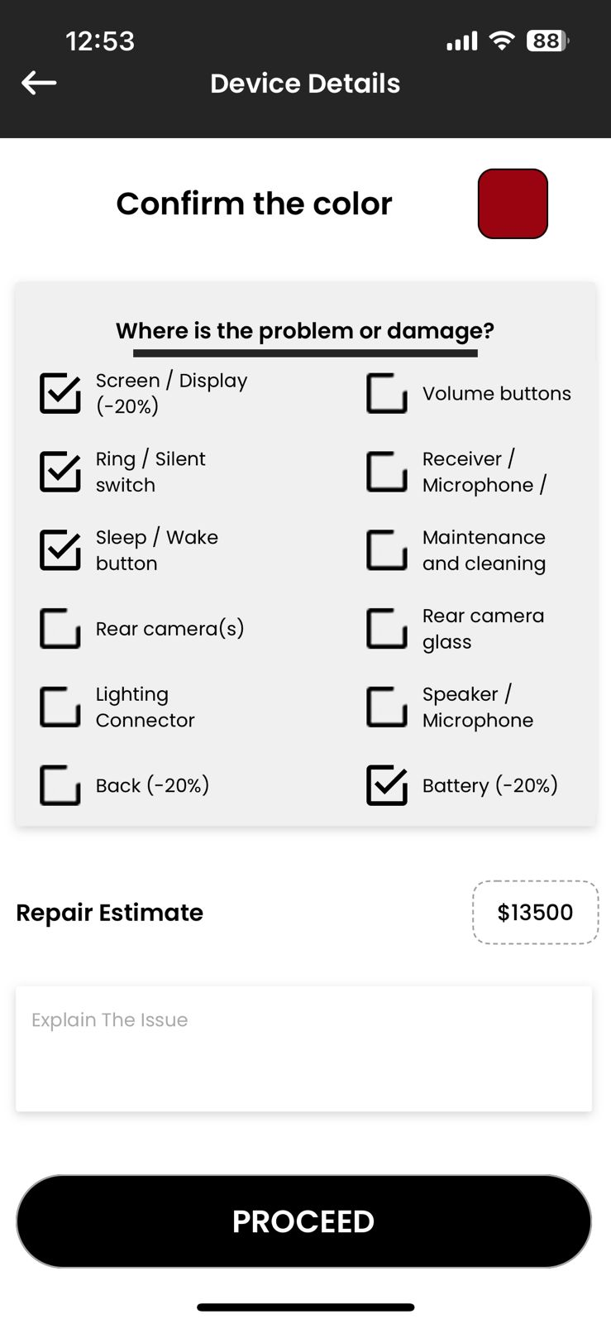


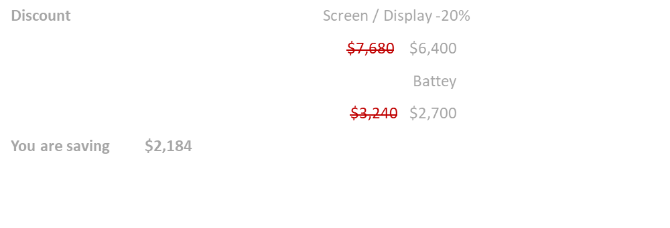
2. Discounts for each of the available options. We must be able to define this in the admin panel. It must be able to see clearly in each item, the % of discount.
The discount must be shown on each item in an eye-catching way.
For Example
If the customer selects an item with a discount, a summary should appear below the repair estimate, showing the service and the price without the discount crossed out and with the discount.
In the end the total savings for the customer

Slide 7
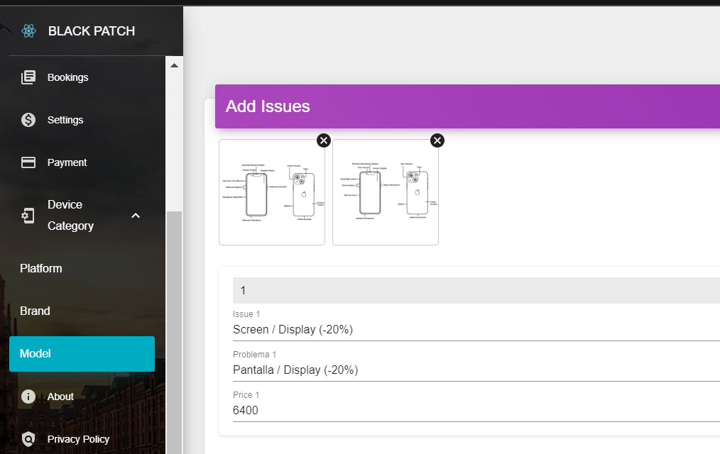
2. Discounts for each of the available options. We must be able to define this in the admin panel. It must be able to see clearly in each item, the % of discount.
Discounts must be applied one by one in the administrator. Each item may or may not have a discount. If a new device is created, it must be able to be ordered and with the same price and discount options.
Price
6,400
Discount
-20%
Discount Price
5,120

Slide 8
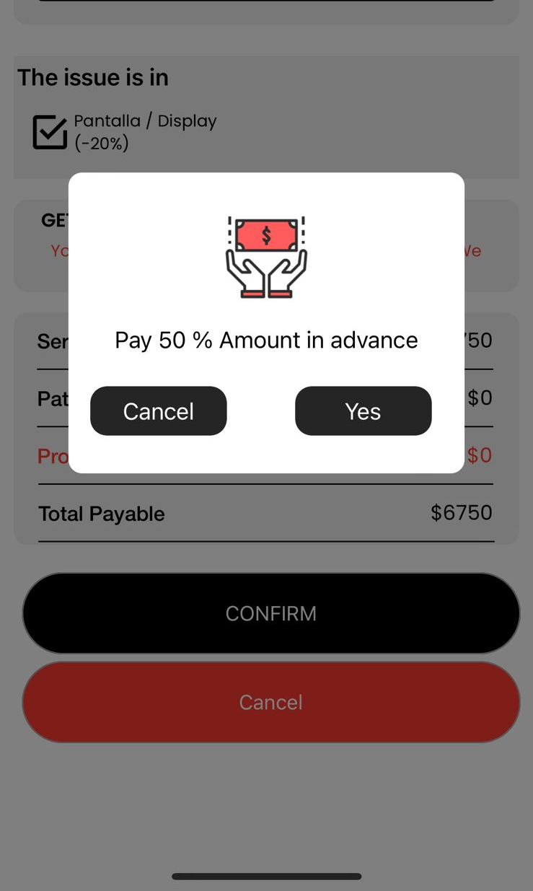
4. Add 2 options to the initial payment of the client:
a. The client can pay 100% from the beginning
b. The client can confirm his service by paying $399 (Normal Service) only refundable if he cancels the service 24 hrs before, after 24 hrs it is not refundable if he cancels the service and the rest at the end of the service.
c. The customer can confirm the service by paying $499 (Express Service) only refundable if the service is canceled 24 hours before, after that it is non-refundable if the service is canceled and the rest at the end of the service.
Normal Mode
Express Mode
100%
Flexibility to reschedule the date and time of service at no additional cost. On-time service guarantee.
100%
Priority
Priority
50%
Re-scheduling can be done at least 24 hours in advance, at no additional cost.
50%
Standard
Standard
$399
Re-scheduling Fee.
Office without cost.
No reimbursement.
$499
Basic
Basic

Slide 9
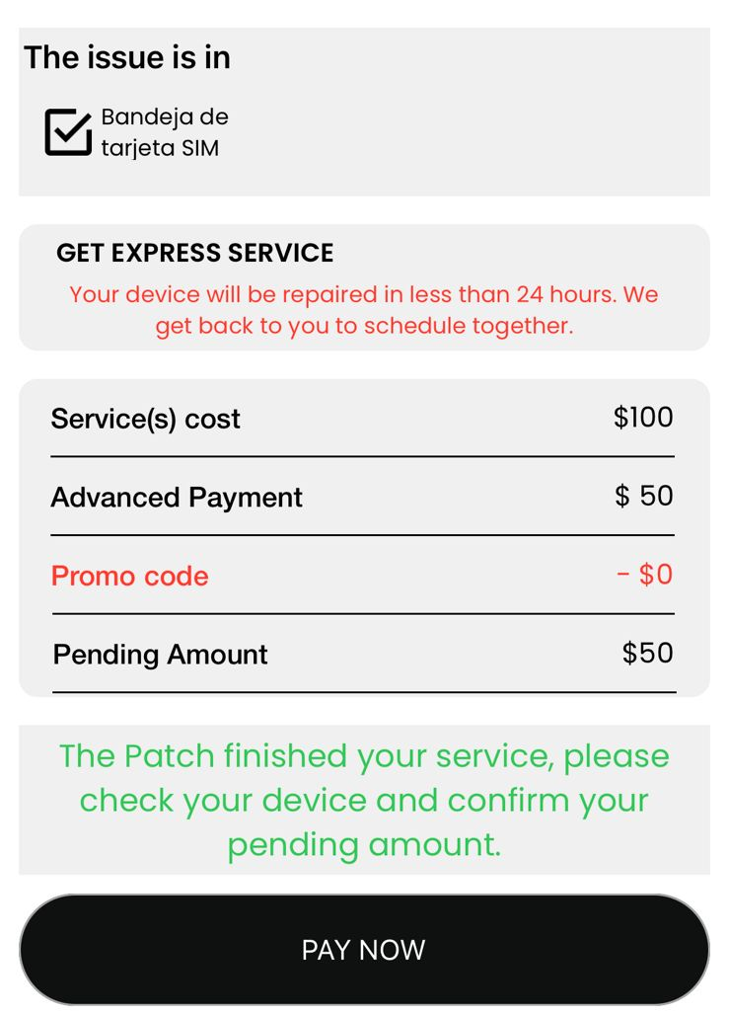
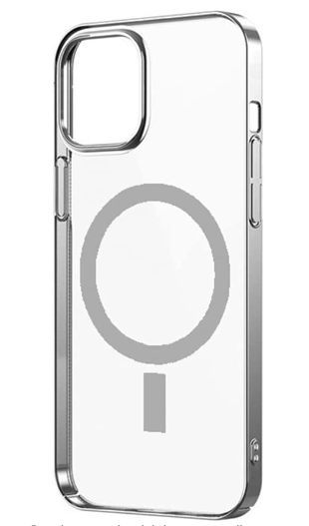
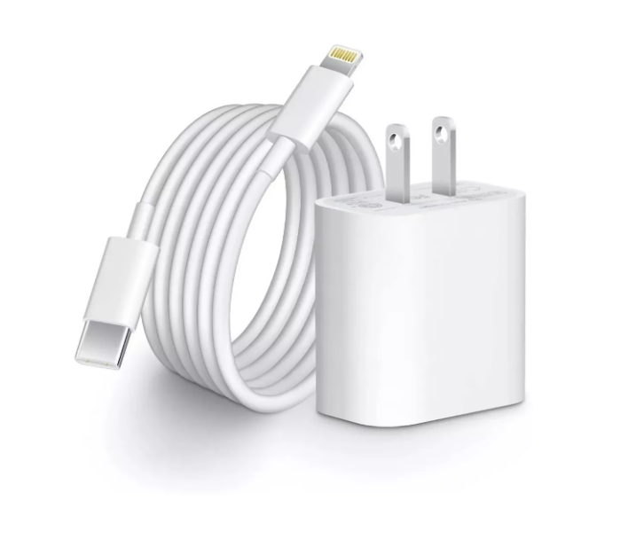
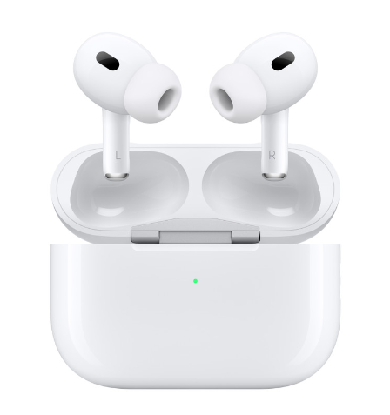
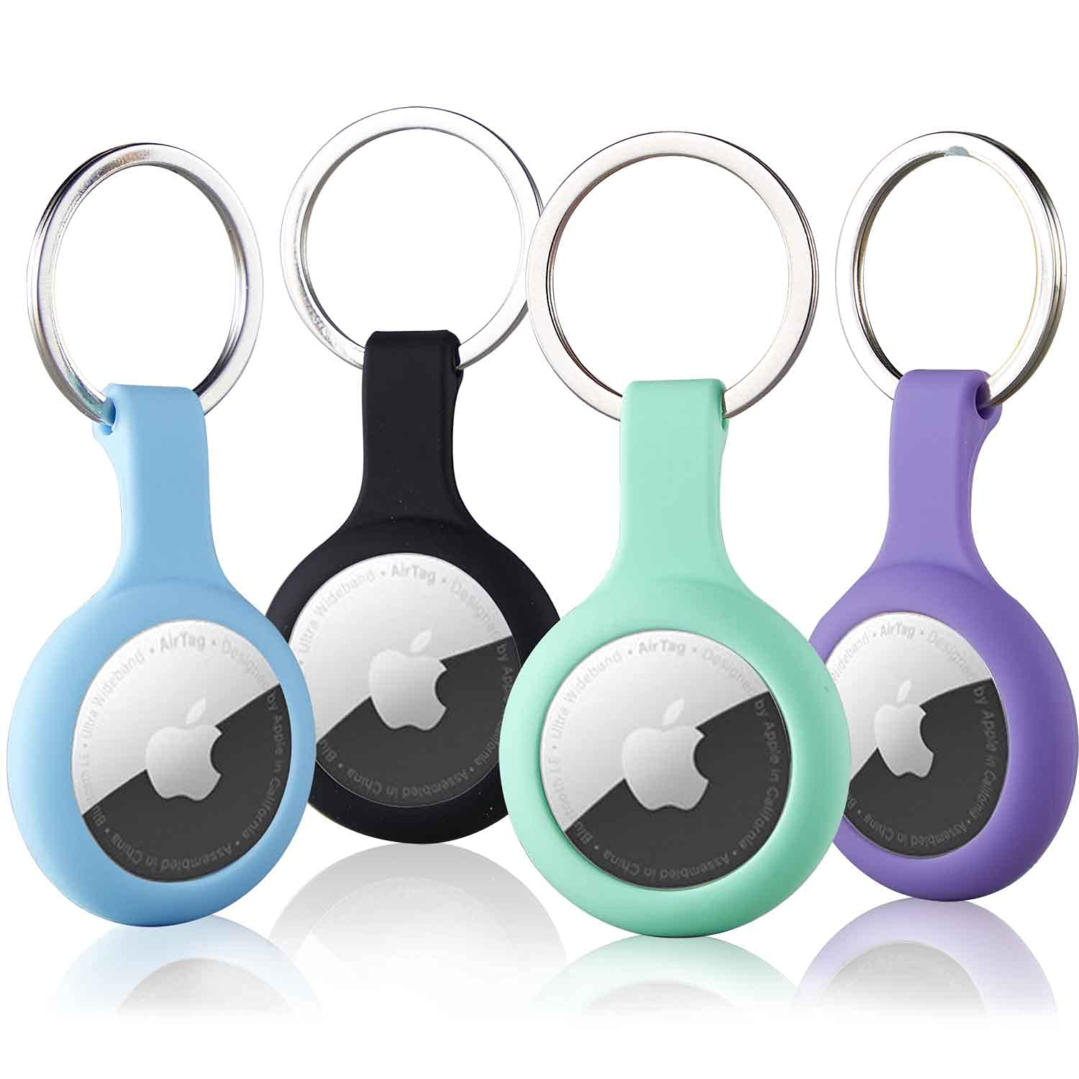
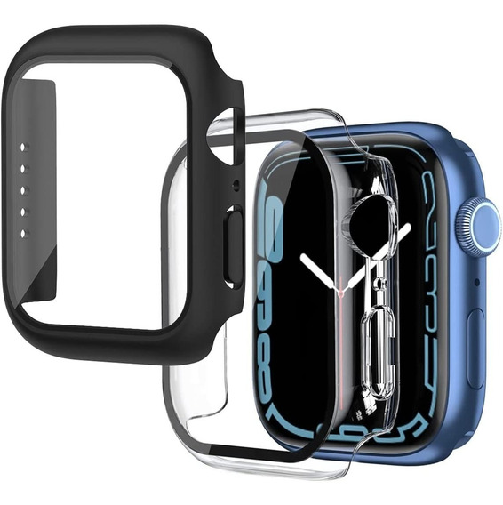
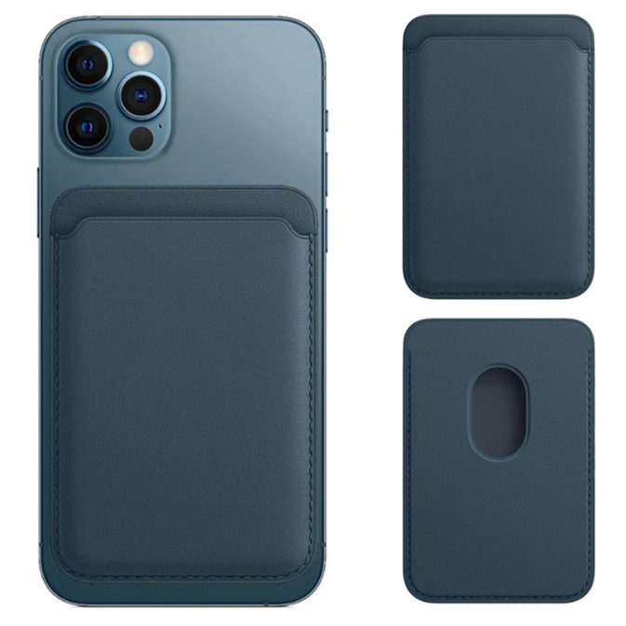
5. The customer may purchase extras. Accessories and some merch.
Click here and the customer will be able to see options that we will add from the admin panel, and we will be able to configure each item with name, price, and an Images. The cost of the extra is added to the total amount pending payment and is displayed in the summary of the total payment.
MagSafe Protector
Cable and charger
Airpods
$300.00
$400.00
900.00
ADD
ADD
ADD
Cable and charger
$400.00
ADD
Airtag
AppleWatch Protector
MagSafe Wallet
$300.00
$400.00
900.00
2
Extras
ADD
ADD
ADD
TOTAL
$800.00
Extended warranty

Slide 10
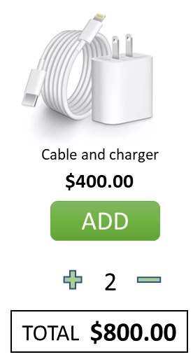
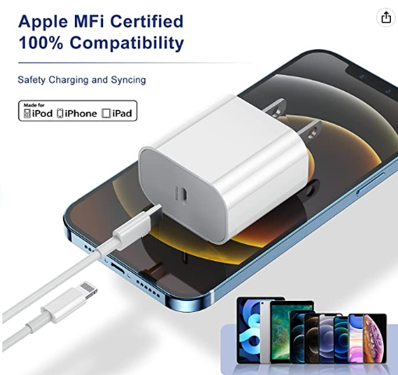
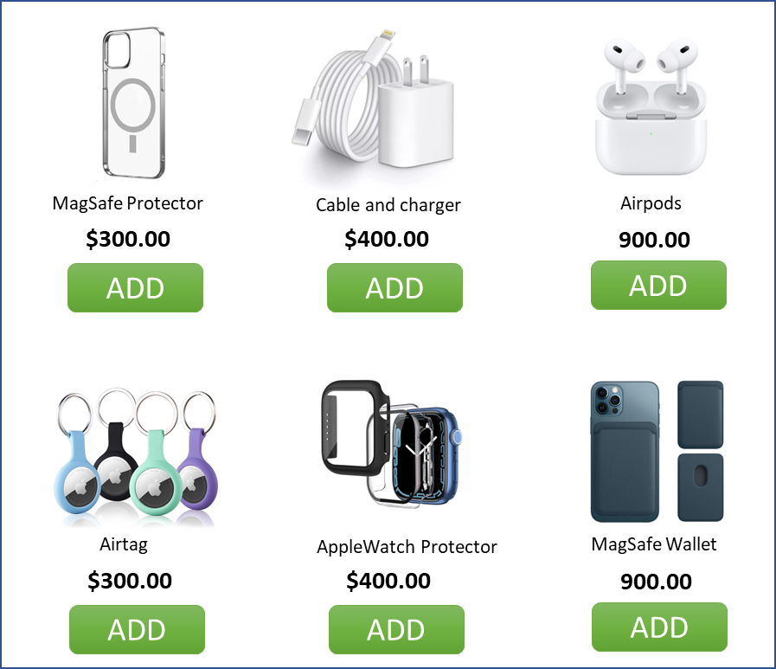

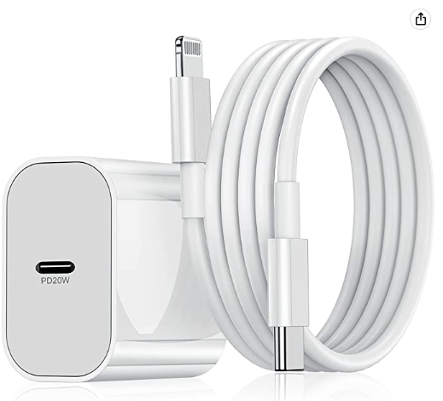
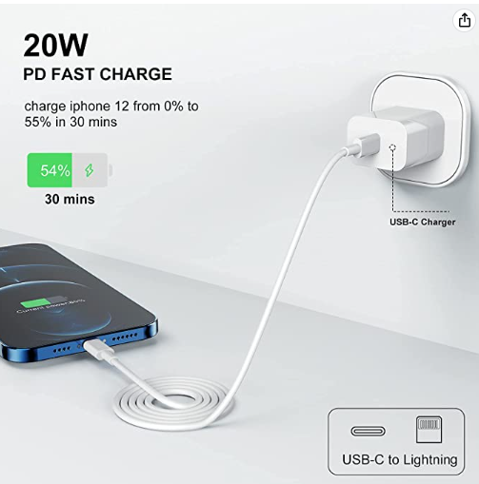
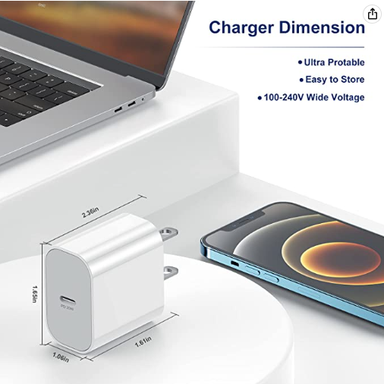
The customer may purchase extras. Accessories and some merch.
Each product need at least 5 images, and a description. The client could add various items and remove them too.
Apple's 20W USB-C power adapter allows you to charge your device quickly and efficiently on the go. While it's compatible with any device that has a USB-C port, Apple recommends using it with the iPad Pro and iPad Air for optimal charging. You can also use it with the iPhone 8 or later to take advantage of fast charging functionality.

Slide 11
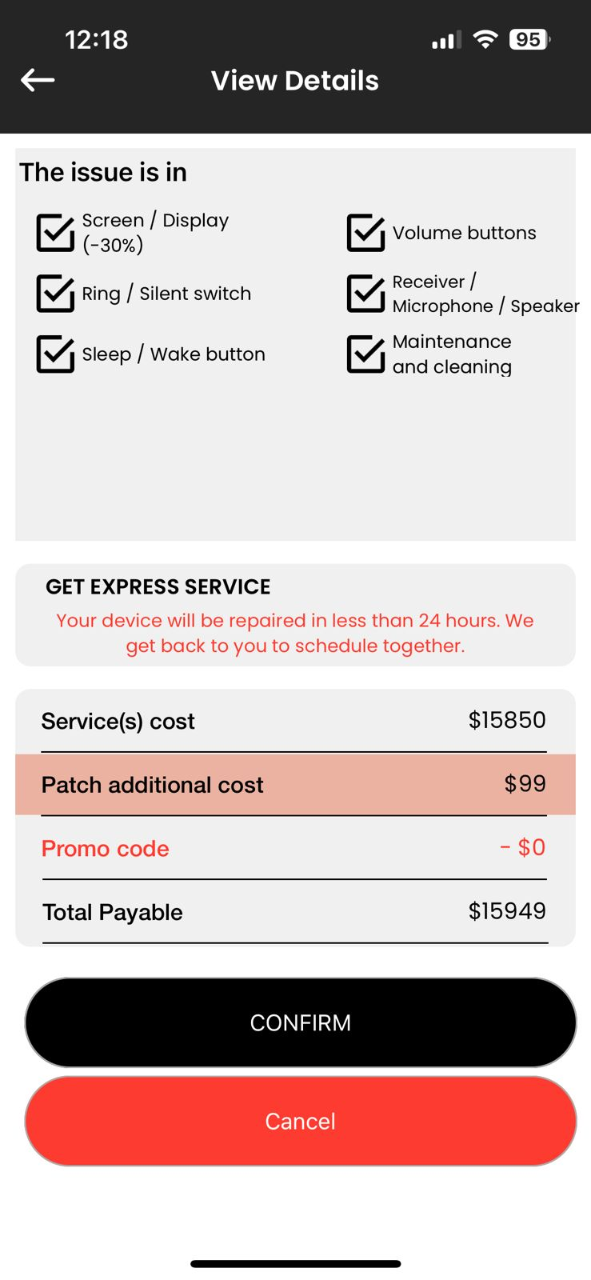

The customer may purchase extras during the hole ongoing service without delivery Fees.
Extras added correctly
Service Total Payable
EXTRAS (2) $800
Apple's 20W USB-C power adapter allows you to charge your device quickly and efficiently on the go. While it's compatible with any device that has a USB-C port, Apple recommends using it with the iPad Pro and iPad Air for optimal charging. You can also use it with the iPhone 8 or later to take advantage of fast charging functionality.
Service + EXTRAS Total Payable
16,749.00

Slide 12
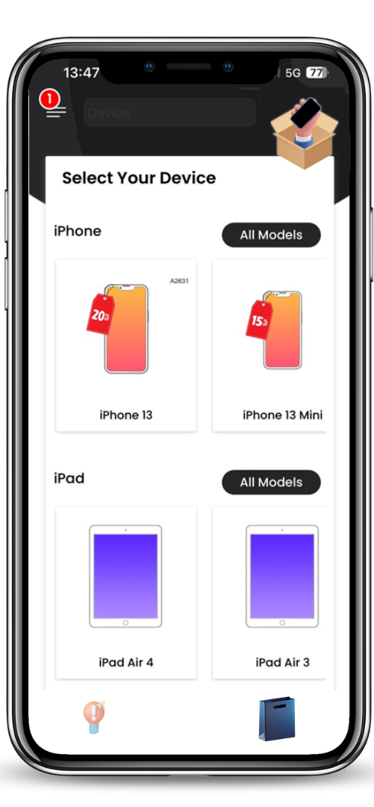
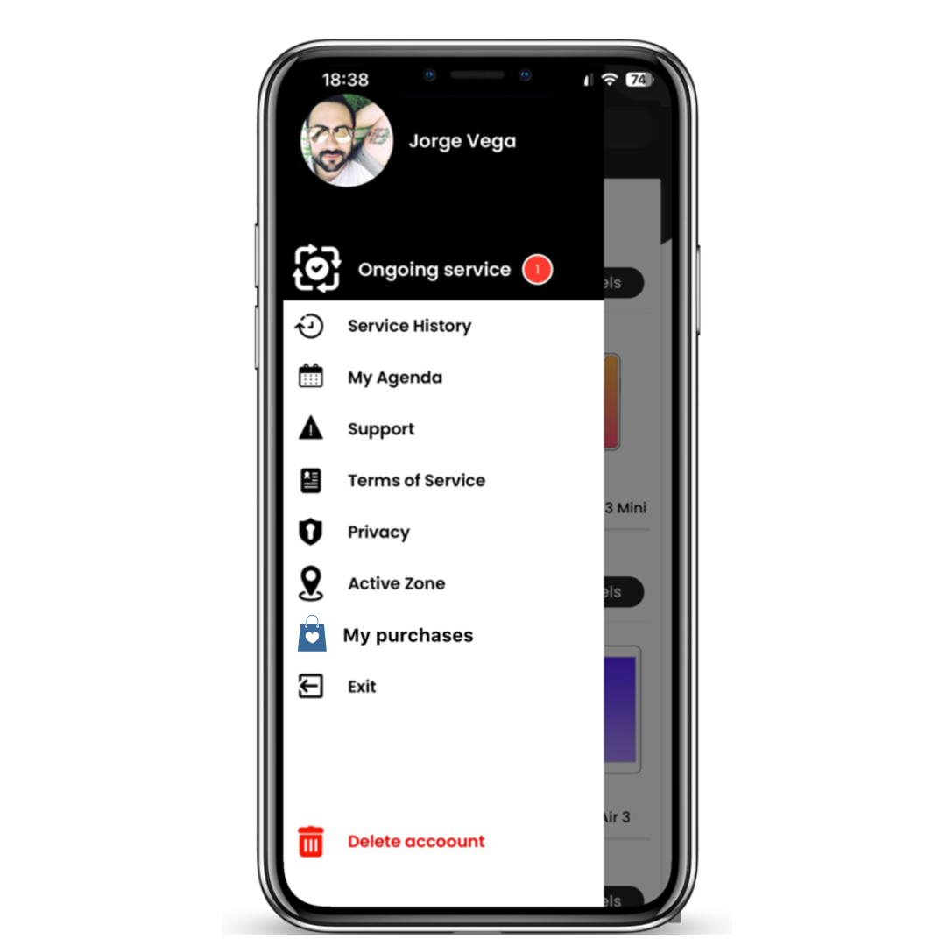
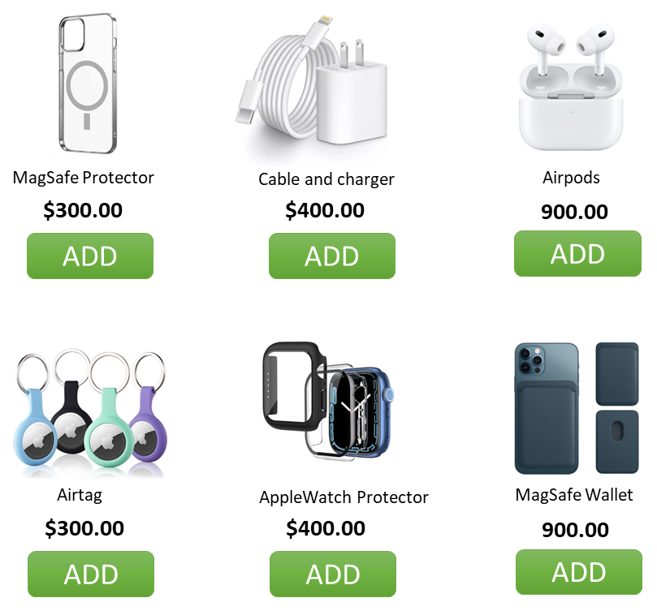
The customer may purchase extras with no an ongoing service. Charging $99.00 MXN for the delivery.
The process is just like the normal service, they just must confirm the Address and the payment will be the 100%.
A resume of the shopping cart and the purchases history
Extras

Slide 13
The customer may purchase extras with no an ongoing service. Charging $99.00 MXN for the delivery.
The process is just like the normal service, they just must confirm the Address and the payment will be the 100%.
Images and product description
Apple's 20W USB-C power adapter allows you to charge your device quickly and efficiently on the go. While it's compatible with any device that has a USB-C port, Apple recommends using it with the iPad Pro and iPad Air for optimal charging. You can also use it with the iPhone 8 or later to take advantage of fast charging functionality.

Slide 14
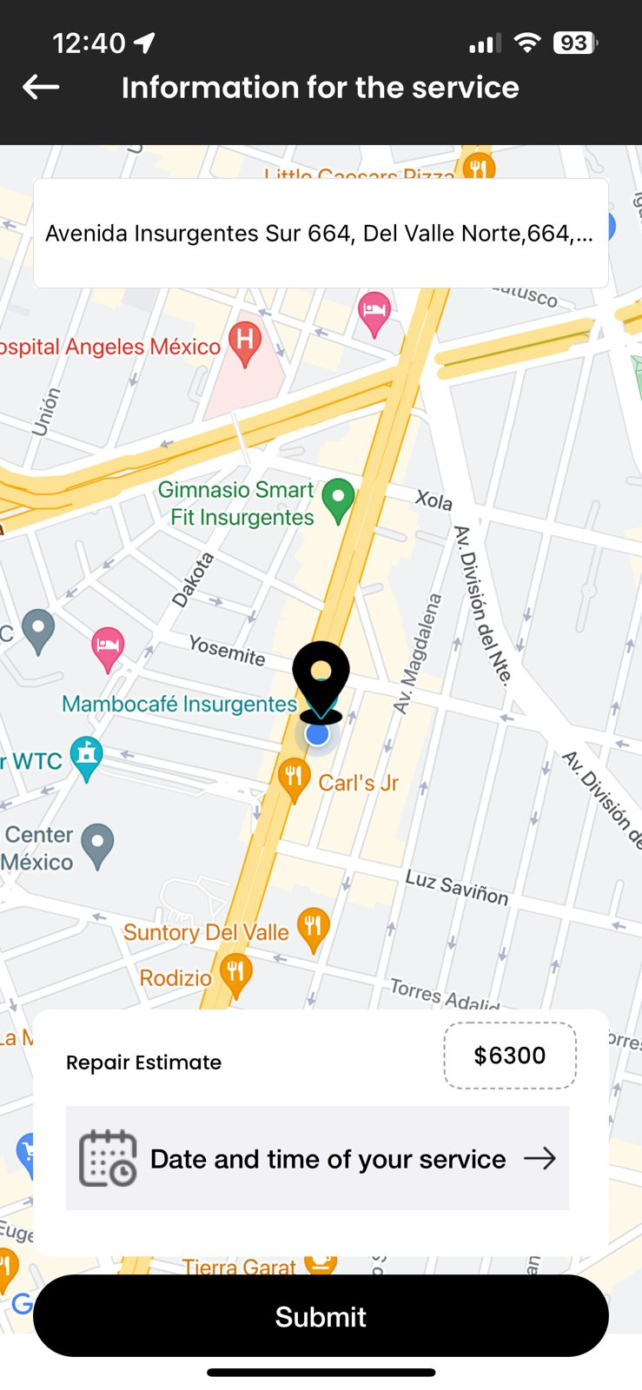


The customer may purchase extras with no an ongoing service. Charging $99.00 MXN for the delivery.
The process is just like the normal service, they just must confirm the Address with the same ZipCode process, and the payment will be the 100%.
The selected product(s) will be delivered within 48 working hours to the indicated address.
Apple's 20W USB-C power adapter allows you to charge your device quickly and efficiently on the go. While it's compatible with any device that has a USB-C port, Apple recommends using it with the iPad Pro and iPad Air for optimal charging. You can also use it with the iPhone 8 or later to take advantage of fast charging functionality.

Slide 15
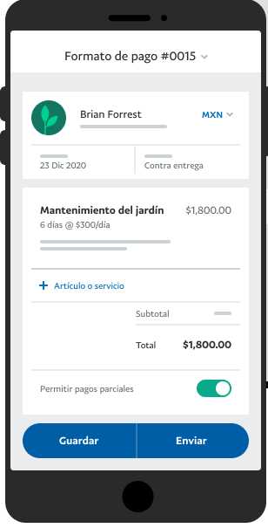
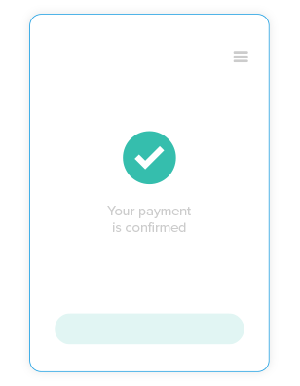



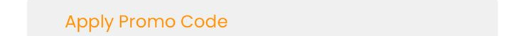

The customer may purchase extras with no an ongoing service. Charging $99.00 MXN for the delivery.
The process is just like the normal service, they just must confirm the Address and the payment will be the 100%.
EXTRAS (2) $800.00
Cable and charger
$400.00
Cable and charger
$400.00
Delivery Fee $99.00
EXTRAS Total Payable
$899.00
Purchase Code
USERCODE+DATE+AMOUNT
Delivery address:
Avenida Insurgentes Sur 674, Colonia del Valle, Ciudad de México, México.

Slide 16
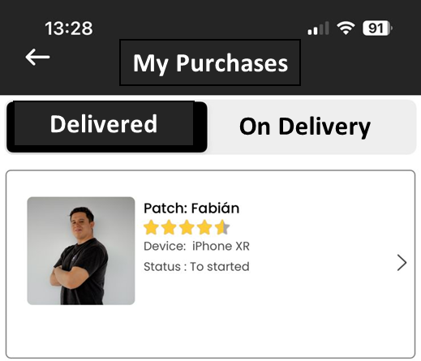


The customer may purchase extras with no an ongoing service. Charging $99.00 MXN for the delivery.
The process is just like the normal service, they just must confirm the Address and the payment will be the 100%.
Status: Delivered
Status: On Delivery Process
Purchase Code
USERCODE+DATE+AMOUNT
Purchase Code
USERCODE+DATE+AMOUNT
Purchase Code
May 12, 2023
EXTRAS (2) $800.00
EXTRAS (2) $800.00
EXTRAS (2)
$899.00
Cable and charger
$400.00
Cable and charger
$400.00
Cable and charger
$400.00
Cable and charger
$400.00
Delivered
On Delivery
Delivery Fee $99.00
Delivery Fee $99.00
May 20, 2023
EXTRAS Total Payable
$899.00
EXTRAS Total Payable
$899.00
EXTRAS (3)
Purchase Code
Delivery address:
Avenida Insurgentes Sur 674, Colonia del Valle, Ciudad de México, México.
Purchase date:
May 12, 2023
Delivery address:
Avenida Insurgentes Sur 674, Colonia del Valle, Ciudad de México, México.
Purchase date:
May 12, 2023
$1,299.00

Slide 17


5.
The extended warranty has a specific cost depending on the device that was serviced. It does not depend on the service done. This amount to be paid by customers must be previously established in the admin panel. This warranty is extended to 200 days the traditional warranty. But it can change later to 300 days or more, affecting only new devices that purchase it.
Each extended warranty covers 2 events within 200 days with a deductible that varies depending on the device. It is important to show the payment information that you would have to make as a % only. This is set by us in the Admin Panel.
Example:
Policy cost $999
Deductible to pay:
Event 1: 10% of the service
Event 2: 15% of the service
Additional data such as the phone IMEI must be entered, and the user code should appear automatically. We share the document that you will find in the service history as "Extended Warranty".
If the customer does not purchase this extended warranty, the traditional 100-day warranty will apply.
Policy owner: Introduced by the client
INCLUDED
ADD
IMEI: Introduced by the client
$0.00
$999.00
User Code Generates Automatically
Protection against manufacturer's defects in spare parts and service.
Protection against accidental damage and technical failures that affect the regular operation of the device. This coverage includes but is not limited to, liquid damage, drops, shocks, and electronic problems.
Client signature
Extras
Extended warranty
Deductible Cost Event 1: 10%
Deductible Cost Event 2: 15%

Slide 18
The extended warranty will be a new option for users and will help them to have "insurance" against damage to their equipment. There will be 2 options for users to acquire it, but in both cases, a technician must confirm that it is valid equipment and must be authorized by the administrator.
Upon completion of a service, the technician will indicate in his App, at the time of returning the equipment that it is viable to acquire the extended warranty. This will give you 100 extra days, going from 100 to 200 days.
Users will be able to acquire this benefit as a traditional service, appearing in the options on each device. The process will be similar to a normal service, since they will have to request a service to CHECK the equipment. The technician will fill out all the information about the equipment, its screen condition, battery, etc., and will mark if it is viable or not to acquire the service. But it will be at a higher price if it is done without any service in progress. In both cases the user will find in his history a section for his warranties. The same user can purchase more than one warranty for different devices.
Policy owner name: Introduced by the client
IMEI: Introduced by the client
This information always be needed and confirmed with the technician.
User Code Generates Automatically
Client signature

Slide 19
Extended Warranty on an ongoing service
At the end of each repair service through the App, the customer will be able to extend the warranty from 100 days to 200 days. Paying an extra amount depending on the model. This option must be available to the user up to 5 days after the service and the model must match the one that was serviced through the App. After 5 days the option to purchase an extended warranty will no longer be valid and must be purchased at a higher price as a new service.

Slide 20
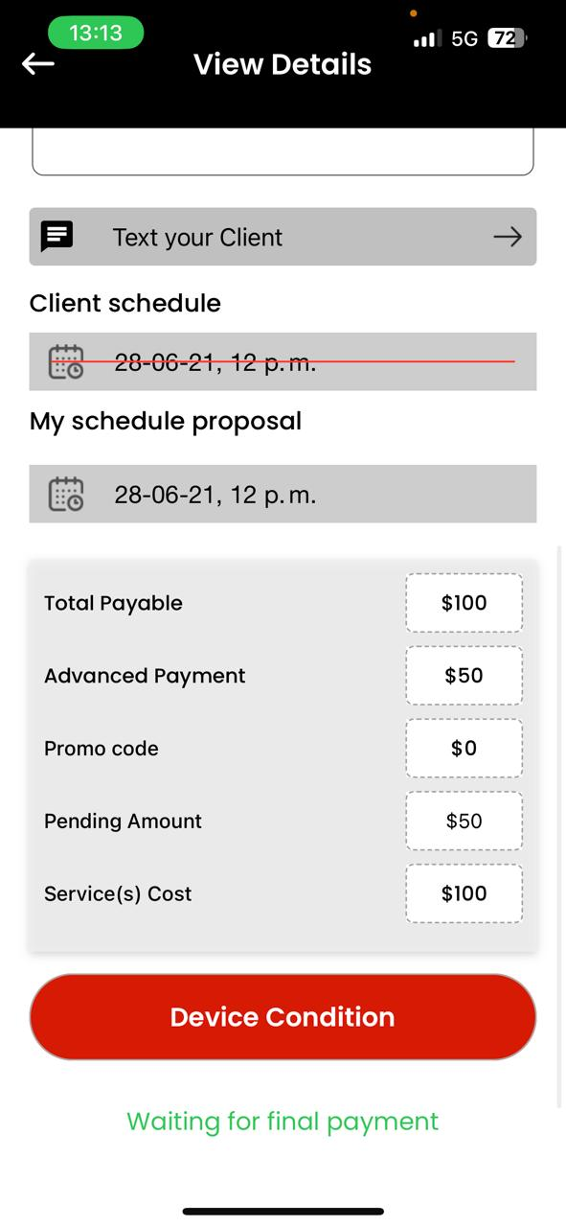
Extended Warranty on an ongoing service
At the end of each repair service through the App, the customer will be able to extend the warranty from 100 days to 200 days. Paying an extra amount depending on the model. This option must be available to the user up to 5 days after the service and the model must match the one that was serviced through the App. After 5 days the option to purchase an extended warranty will no longer be valid and must be purchased at a higher price as a new service.

Slide 21
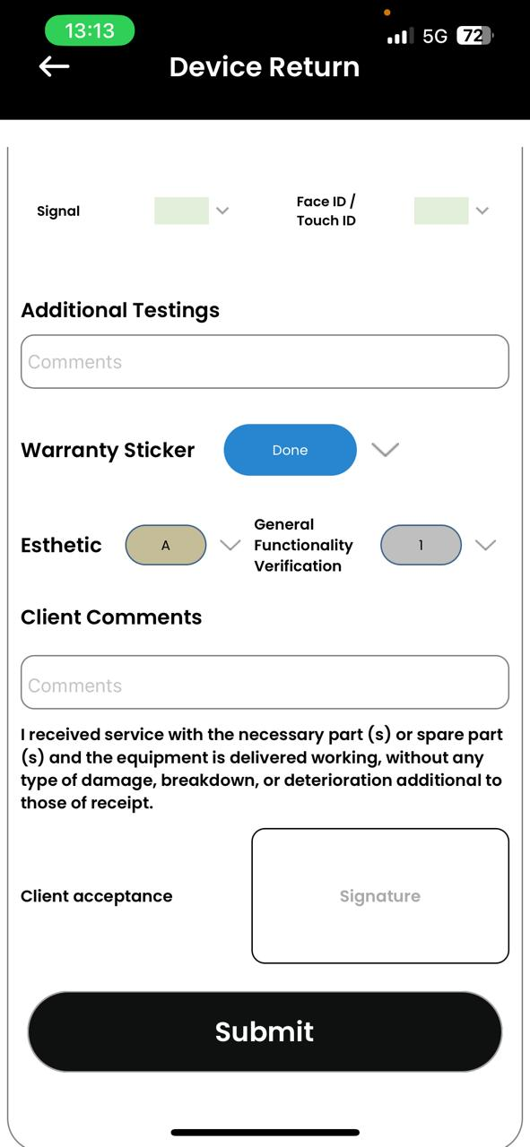
The process for the customer to acquire the extended warranty at the end of a service will be as follows:
the technician must complete the information about the condition of the equipment and check a new box labeled "Equipment viable for warranty" and with options of Yes or No.
2) If the technician checks Yes, the user will be able to acquire the warranty at the end of the repair process and up to 5 days after the repair.
3) The customer will fill out the warranty information (Name, IMEI, Signature and user number will be generated automatically).
4) The payment must be 100% in one payment.
5) From the Admin Panel the extended warranty will be activated notifying the user that the process has been successful. In this step it will be verified that the information has been filled out correctly.
6) The current traditional warranty must be replaced by the new one with the data provided, warranty cost, percentages to be paid in the 1st event and in the 2nd event, start date and end date.
If the technician marks No, the user will not have the option to purchase the extended warranty and only the traditional warranty will appear for 100 days.
Equipment viable for warranty
Yes
NO

Slide 22
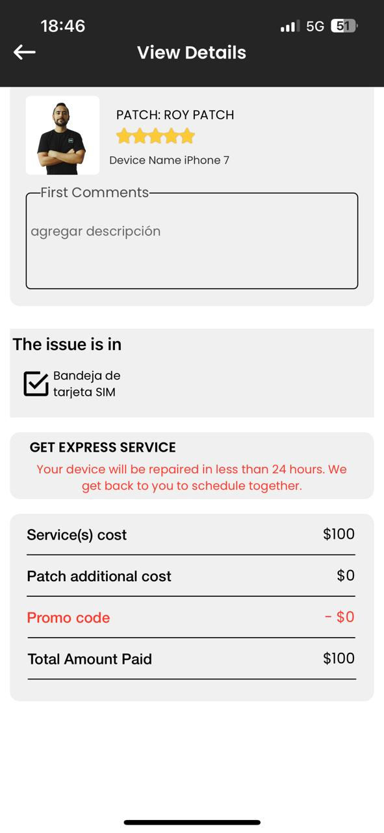
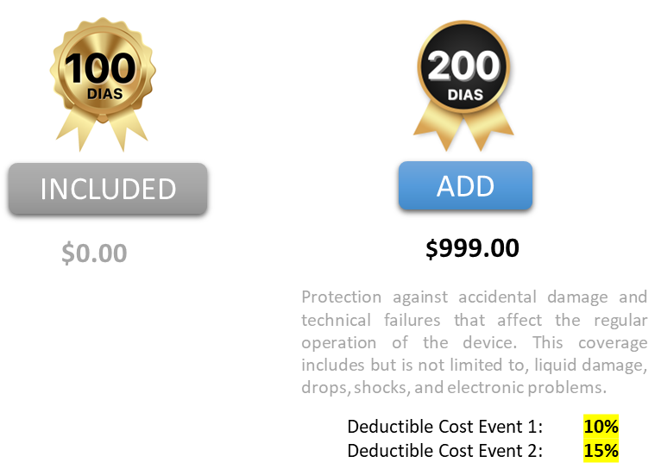
If the technician confirms that the equipment is viable for warranty, this button for the purchase of the extended warranty is activated. Otherwise, only the 100 days button will appear.

Slide 23
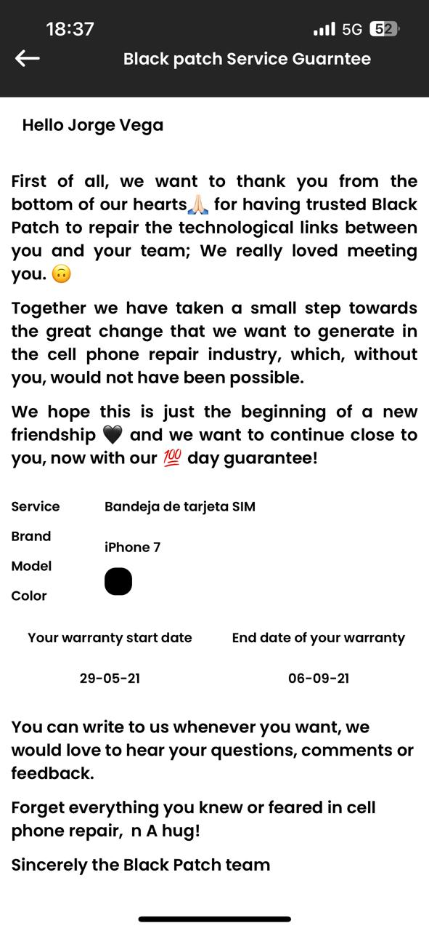

Slide 24
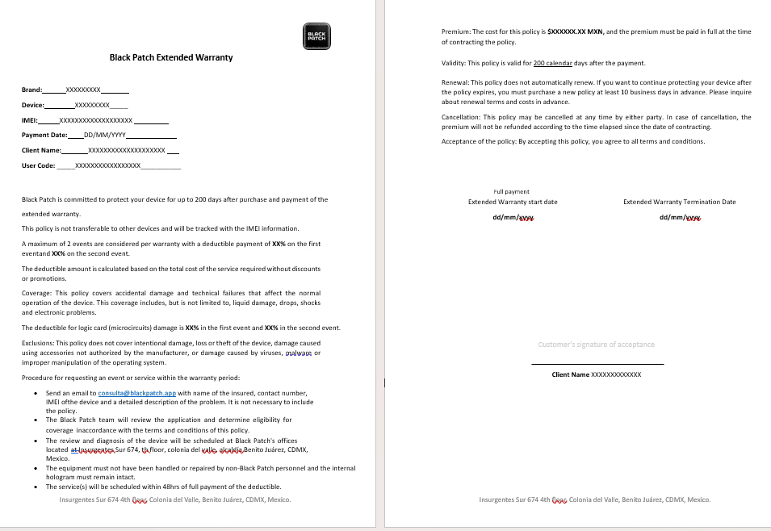
I will share with you the files in English and Spanish for the extended warranties.

Slide 25
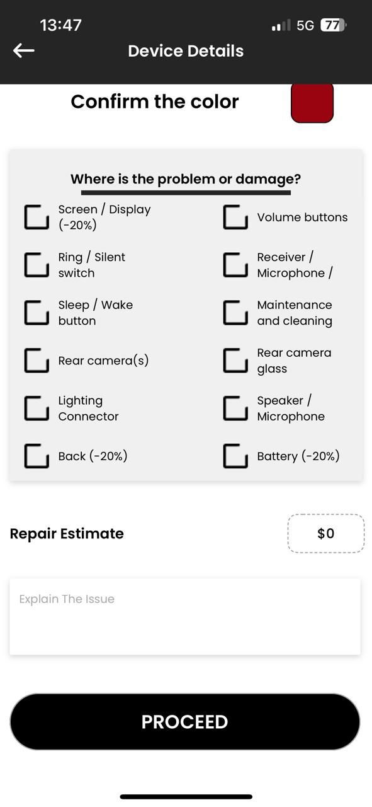
Extended warranty with no ongoing service
Any user may purchase an extended warranty without an ongoing service or prior service. This is purchased as a normal service, which requires to be scheduled like traditional services. The user will select the extended warranty option from the device menu and the quote will appear. The user will schedule it and pay the down payment. The technician will go and fill out the service sheets to mark the option "Viable equipment for warranty", and it would be the same process.
2) If the technician checks Yes, the user will be able to acquire the warranty at the end of the repair process and up to 5 days after the repair.
3) The customer will fill out the warranty information (Name, IMEI, Signature and user number will be generated automatically).
4) The payment must be 100% in one payment.
5) From the Admin Panel the extended warranty will be activated notifying the user that the process has been successful. In this step it will be verified that the information has been filled out correctly.
6) The current traditional warranty must be replaced by the new one with the data provided, warranty cost, percentages to be paid in the 1st event and in the 2nd event, start date and end date.
Extended Warranty

Slide 26
7. Add a button on the main screen of the client's app that redirects them to an external online store that we are testing to buy. This button should be able to activate or deactivate it and change the text from the admin panel.
The link send to This page
https://blackpatch.mitiendanube.com/que-es-pre-loved/
A resume of the shopping cart and the purchases history
Extras

Slide 27
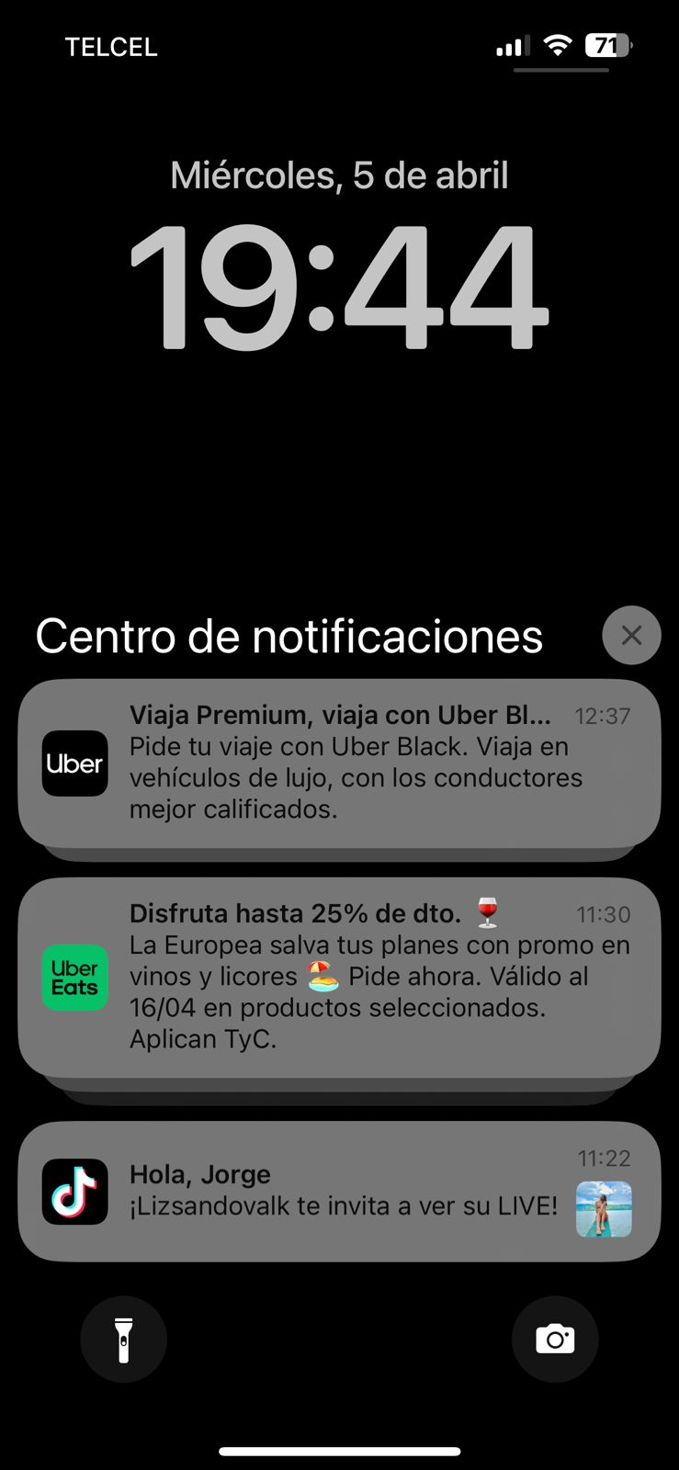

9. To be able to create and send personalized Push notifications to the users that have the App downloaded.
Hot Sale Discounts 🔥
Qwertyuiopásdfghjklñzxcvbnmqwertyuiopasdfghjklñzxcvbnm.
Especial Discounts 🖤
Qwertyuiopásdfghjklñzxcvbnmqwertyuiopasdfghjklñzxcvbnm.
-30% off on Batery 🔋
Qwertyuiopásdfghjklñzxcvbnmqwertyuiopasdfghjklñzxcvbnm.

Slide 28
The information in the Admin Panel must be organized from the most recent to the oldest and must be filtered. For example, in the zip codes we must be able to see which already exist in order not to duplicate them, to be able to filter them and to be able to order them.
We must be able to order all the devices.
PENDING

Slide 29
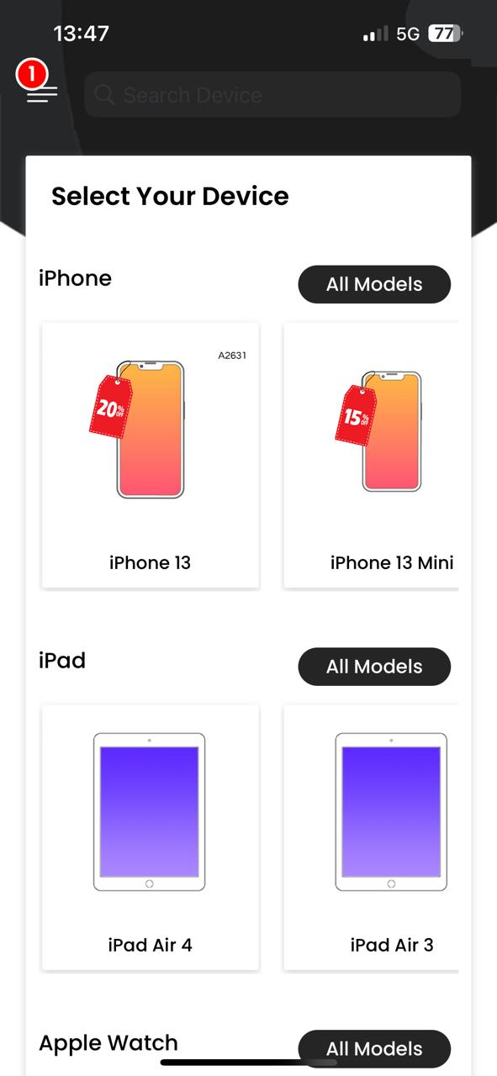
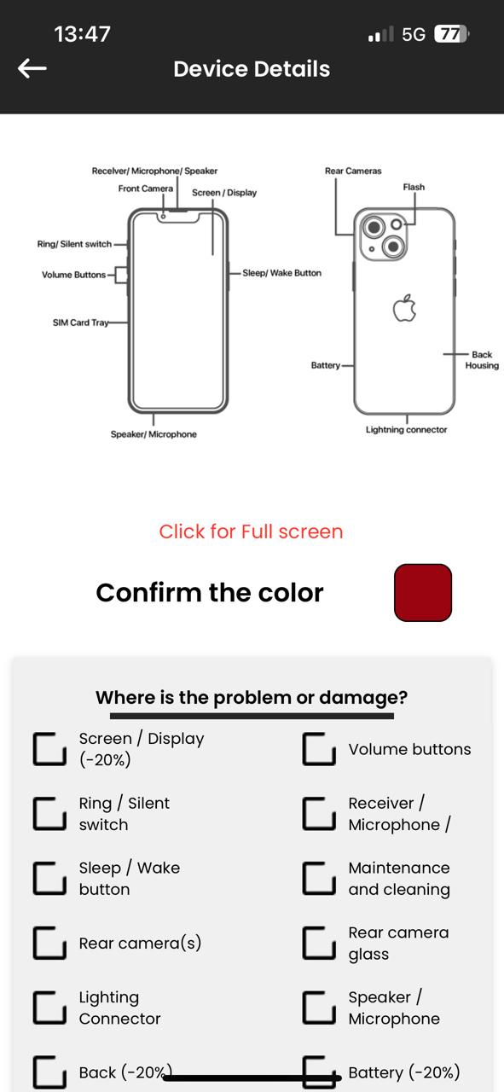
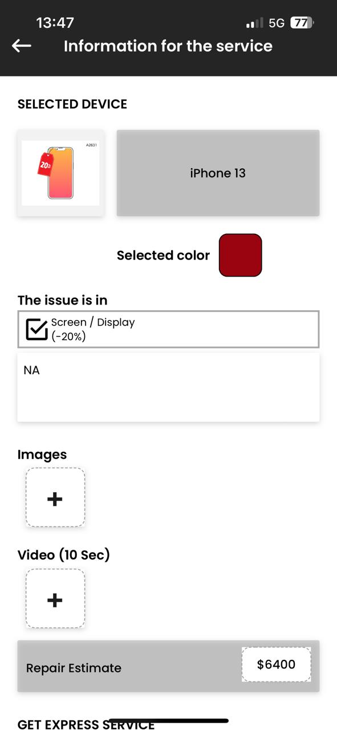
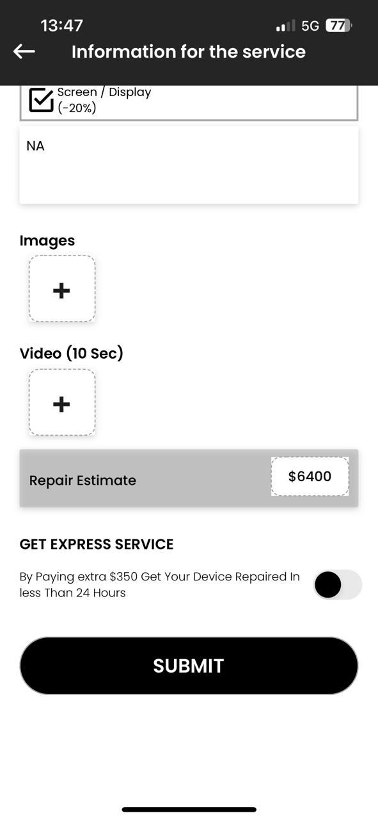

English
8. Update some texts of the App. This texts will help users on each screen to use the service
Find the model. You can confirm this by the model code (A2631).
Get the quote for your equipment. There are no additional charges.
You will improve your experience by sharing the problem in your own words.
Attach photos and videos for our Patches
The Express option will put you at the beginning of the scheduled services.

Slide 30
SPANISH
8. Update some texts of the App. This texts will help users on each screen to use the service
Encuentra el modelo. Puedes confirmarlo por el código del mismo. (A2631)
Obtén el presupuesto para tu equipo. No hay cobros adicionales.
Mejorarás tu experiencia al compartirnos en tus palabras el problema.
Adjunta fotos y videos para nuestros Patches
La opción Express te pondrá al principio de los servicios agendados.

Slide 31
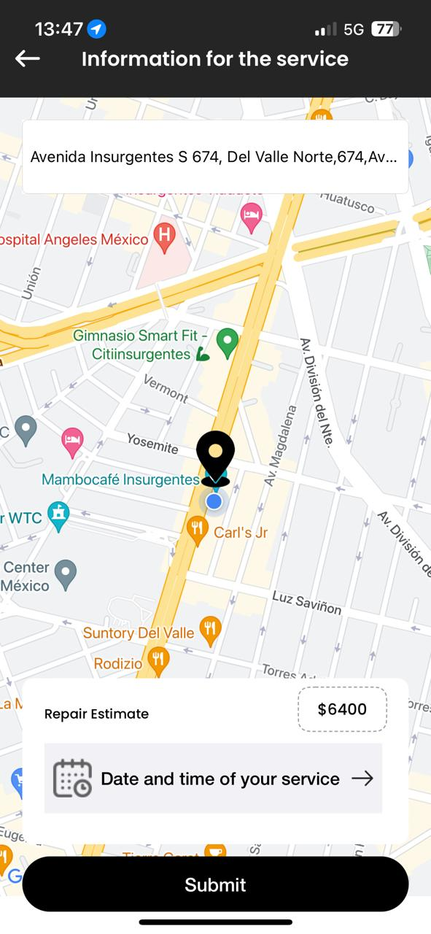
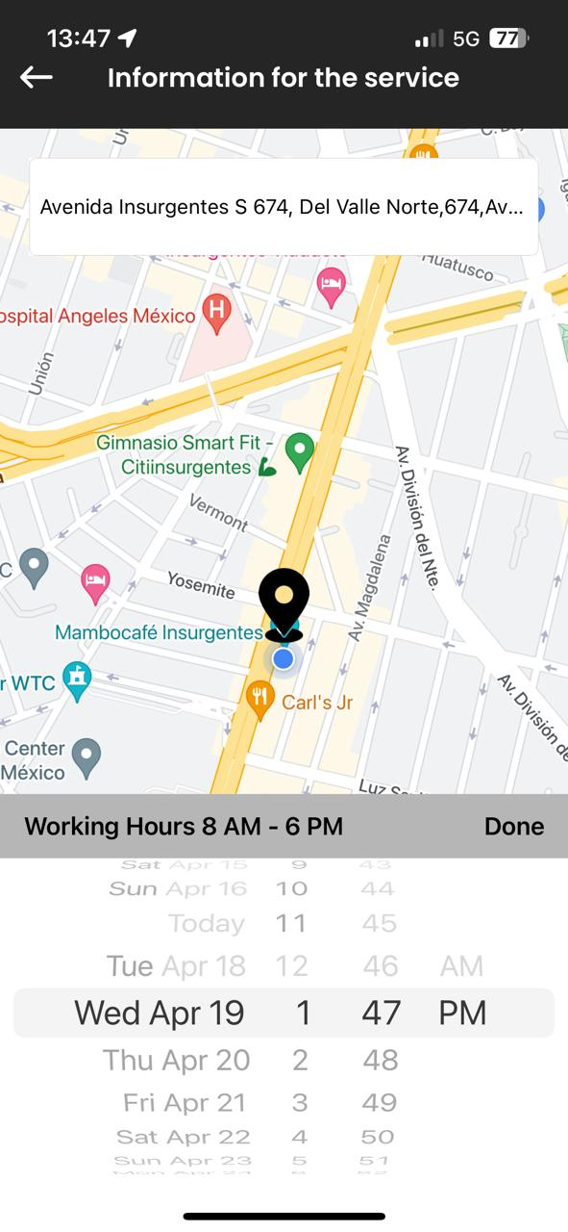
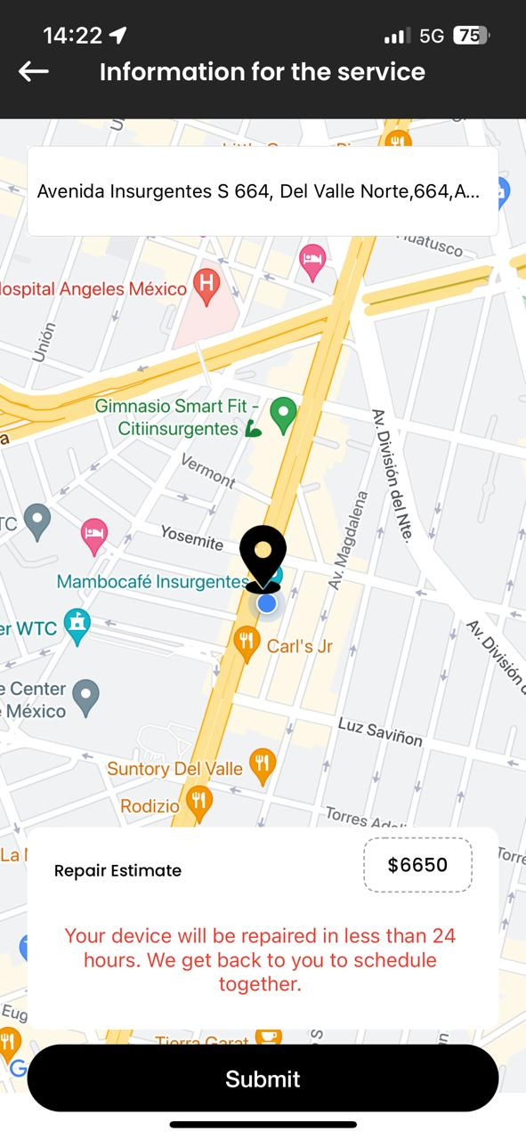
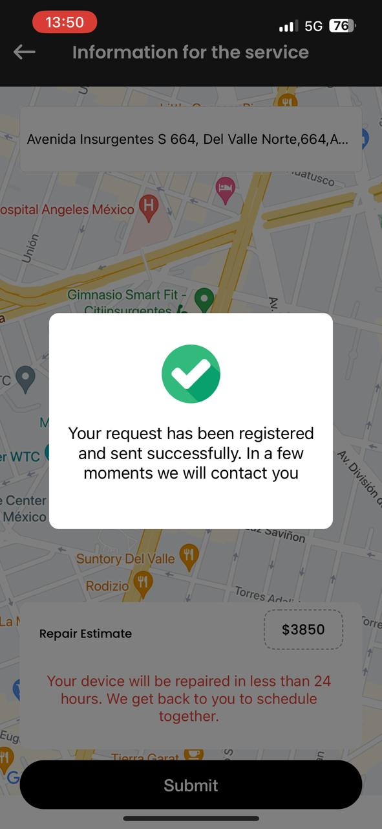
English
8. Update some texts of the App.
You can choose your home, office and favorite coffee shop. No payment is required yet.
If you need the service urgently, remember that we have an Express option one step before.
In the Express mode, you must send your request so that a Patch can confirm the available times. No payment is required yet.
Your service has been requested, but not yet confirmed. Wait for the confirmation of the Patch to make the first payment.

Slide 32
8. Update some texts of the App.
SPANISH
Puedes elegir tu domicilio, oficina o cafetería favorita.
Aún no es necesario realizar ningún pago.
Si te urge el servicio, puedes elegir la opción Express.
En el modo Express deberás enviar tu solicitud para que un Patch te confirme los horarios disponibles. Aún no es necesario realizar ningún pago.
Tu servicio fue solicitado, pero aún no está confirmado.
Espera la confirmación del Patch para realizar el primer pago.

Slide 33
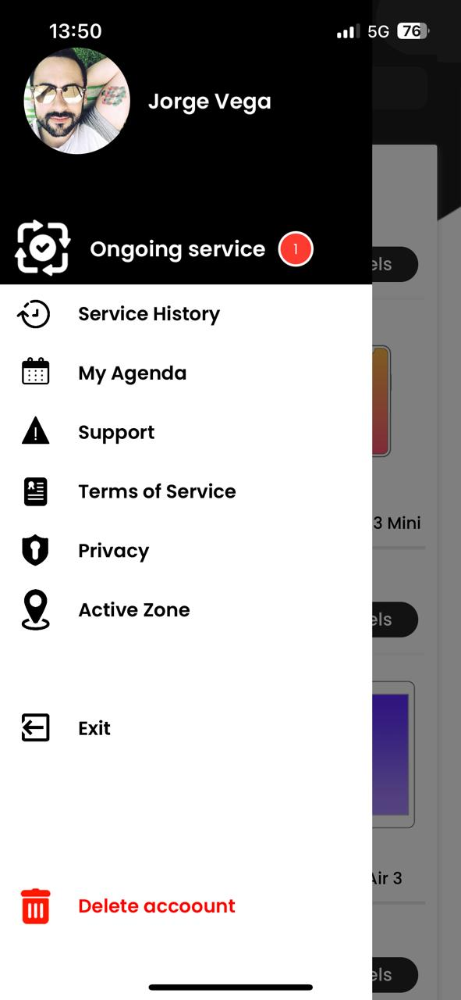




English
8. Update some texts of the App.
You can follow up in "Ongoing Service".
Your service is under review. It has not yet been accepted. This process may take a few minutes.
Your service has been accepted. Now you can make the advance payment to confirm it.
This is the breakdown of the cost of your service. If you have any questions you can call Patch.
Remember that you can pay with any credit or debit card in a safety way.

Slide 34
8. Update some texts of the App.
SPANISH
Puedes dar seguimiento en “Servicio en Curso”
Tu servicio está en revisión. Aún no se ha aceptado. Este proceso puede tomar unos minutos
Tu servicio ya fue aceptado. Ya puedes realizar el pago del anticipo para confirmarlo.
Este es el desgloce del costo de tu servicio. Si tienes dudas puedes marcar al Patch.
Recuerda que puedes pagar con cualquier tarjeta de crédito o débito de forma segura.

Slide 35
In addition, we must confirm that the calendar and referral discount processes are working correctly.
PENDING

