Slide 1
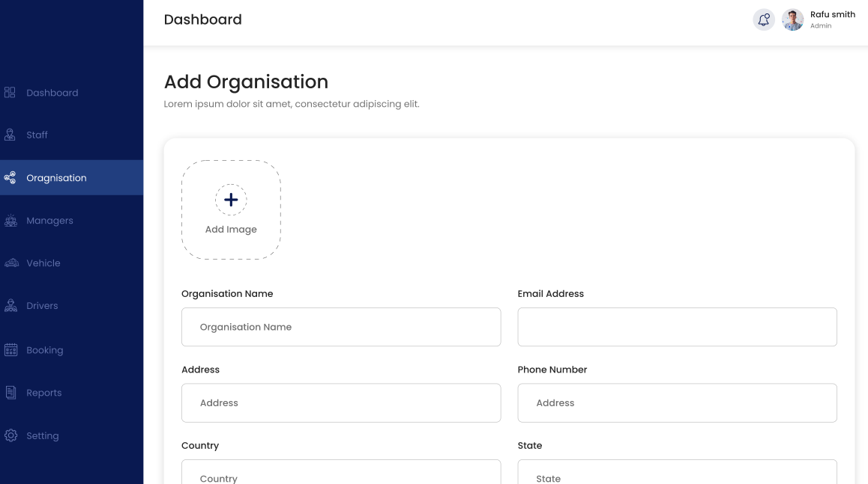
Links should be:
Dashboard (admin only)
Bookings
Organisations (admin only)
Users (Admin and sub-admin only)
  All users
  Roles and permissions (admin only)
Vehicles (Admin and sub-admin only)
Reports (Admin only)
Settings

Slide 2
Dashboard (admin only for now)
Show statistics for bookings
  Total volume (number of rides)
  Volume today
  Volume for next 7 days
  Volume per day for next 7 days
  Unassigned drivers for next 48hrs (number of bookings where driver not assigned)
  This will be developed later on with features like flight tracking. Would be very useful for our application to fetch arrival information for todays flights and inform of any conflicts.

Slide 3
Organisation list view (admin only)
Should be labeled ”Organisations”
Only visible to admin
Info for organizations (those in bold should be in the Org overview as columns)
    Trading name
    Legal name
    Business ID
    VAT ID
    Address
    Tel.
    E-mail
    Country (show flag)
    Document upload (Logo, Certificate of incorporation, insurance policy, transport license)
    Operations contact (name, tel, email)
    Financial contact (name, tel, email)
    Sub-admin (which user ”owns” this organization)

Slide 4
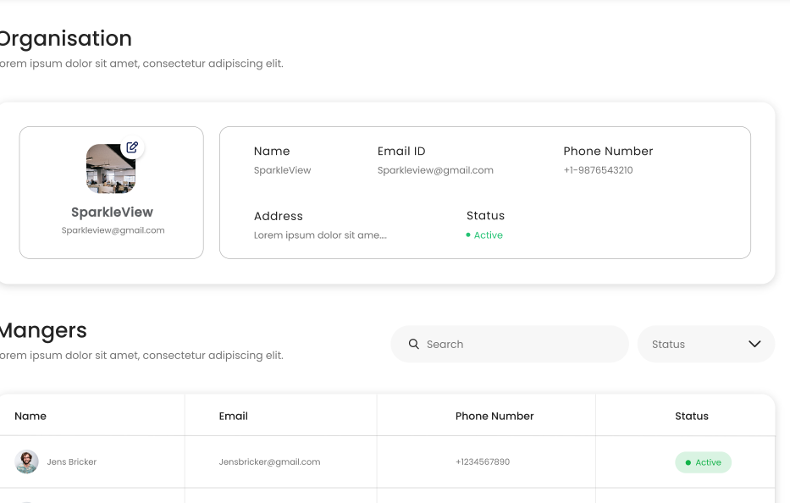
Organisation view
Show info from slide 3. Admins can edit, sub-admins can view.
This isnt needed as all info is in Users section

Slide 5
Add & edit organisation views are fine. Fields in slide 3.

Slide 6
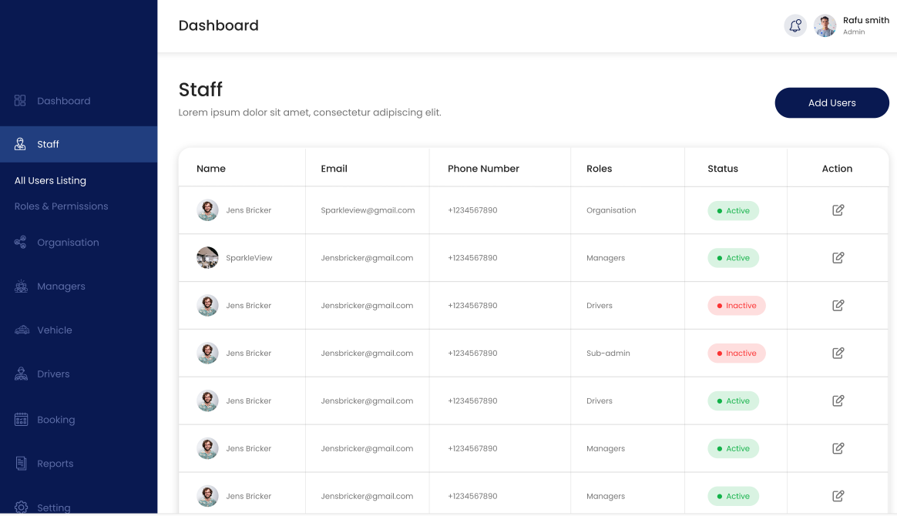
Title should be ”Users” instead of ”Staff”.
Admin sees all users. Sub-admins see users for their organization. Drivers and managers cannot access view
Columns should be Display name, email, tel, Role, Action

Slide 7
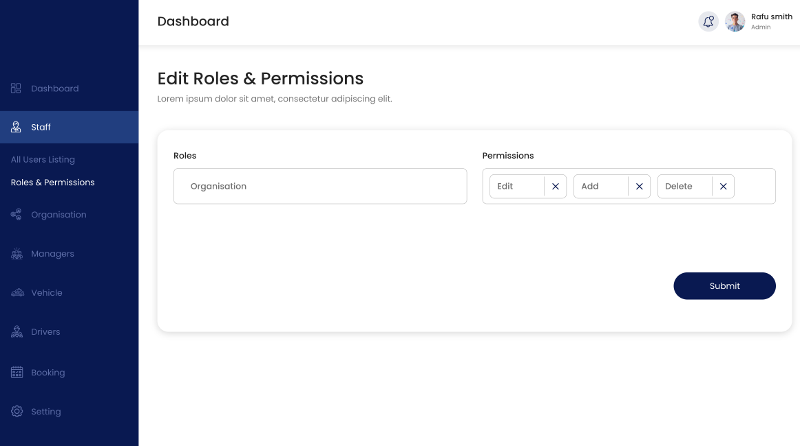
Permissions are:
Acknowledge booking (sends info to booking.com API and others when added. Only admin can acknowledge)
Decline booking (sends info to booking.com API and others when added. Only admin)
Assign booking to organisation (admin only)
Assign booking to driver (admin, sub-admi, manager)
Add booking (admin)
Edit booking (admin)
Delete booking (admin)
View prices (currently only Admin can see prices)
View agent (currently only Admin can see the source of the booking i.e. Booking.com, MyTransfers etc.)
Add/edit/delete drivers (admin & sub-admin)
Add/edit/delete vehicles (admin & sub-admin)

Slide 8
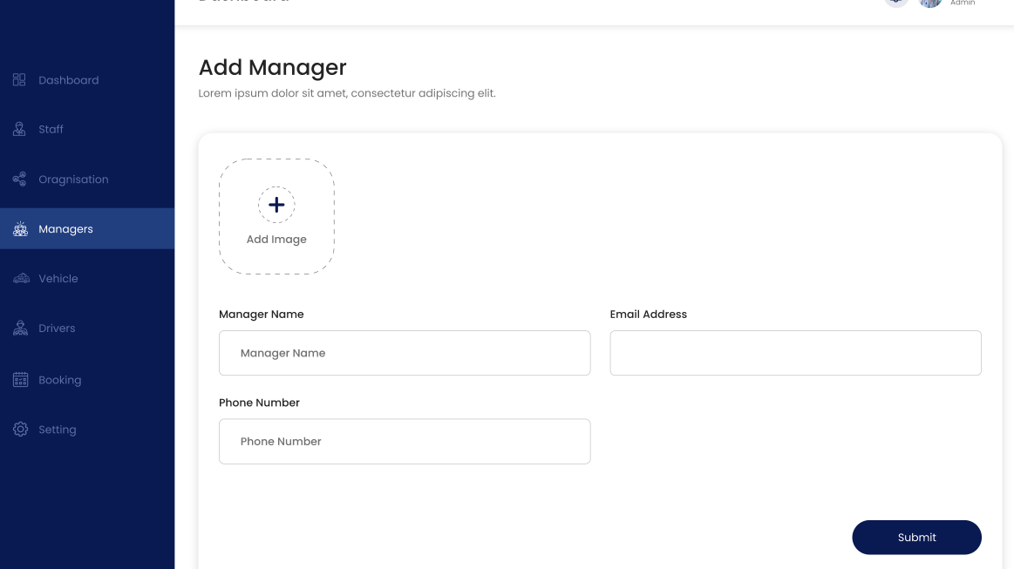
Similar view for all user types. Admins can create users for all organisations and sub-admins can create users for their own organization. Managers and drivers cannot see this view.
Info for users: First name, Last name, display name (must be unique), organisation (if admin, otherwise always defaults to users org), tel no., email, role (admin, sub-admin of organization, manager, driver), date of birth, document upload for picture and copy of taxi driver/operating license. Should also have a unique driver ID and ability to map our internal IDs to agent driver Ids (e.g. Booking.com will have internal Ids for all drivers established in booking.com system. Only admin can view or edit this mapping info).

Slide 9
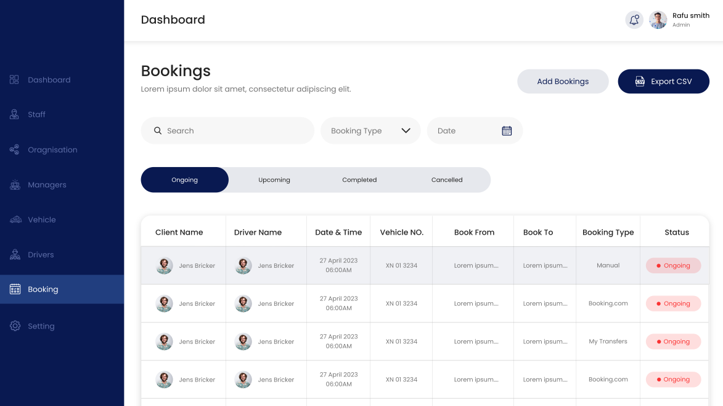
Columns should be
Agent (currently booking type. Only Admin can see this info)
Pick-up date & time
Passenger name
From country (flag)
From place
To Country (flag)
To place
Flight number
Passenger name
Number of Passengers
Number of child seats
Tel no.
Organisation (Admin only. Shows organisation this has been assigned to. Can show an oval like the Status columns below saying ”Unassigned” in yellow or Organisation name in green if assigned. When clicked, this can open a dropdown of available organisations)
Driver (Admin/sub-admin/manager only. Shows driver display name this has been assigned to. Can show a yellow oval saying ”Unassigned” or green with display name if assigned. When clicked, this can open a dropdown of available drivers)
Vehicle (Admin/sub-admin/manager can assign vehicles. Driver can view vehicle. Yellow oval with ”Unassigned” or vehicle registration in green if assigned.)
Status (only Admin can see cancelled rides. For other user types, they just disappear from the listing.)

Slide 10
Should be able to filter by
Country (if Finland selected, should show all going to or from Finland)
Date (range or single)
Driver
Agent (Admin ony)
Vehicle class
Organisation (Admin only)
Should be able to search by
Name
Finbound reference (our own unique booking ID)
Agent reference (booking ID supplied by agent)
Slider should show following statuses:
New (admin only)
  Shows new unacknowledged rides from Booking.com and later other agents
Upcoming
  Shows all rides from today onwards
Ongoing
  Shows rides where first driver event has been submitted. Status changes to ”Missing data” if driver events not submitted within 6hrs of pick-up date.
Completed
  Shows past rides (including those with missing data). Drivers cannot see past rides
Pending changes (admin only)
  Show bookings pending modifications from Booking.com.
Cancelled (admin only)
Only admin can export bookings.

Slide 11
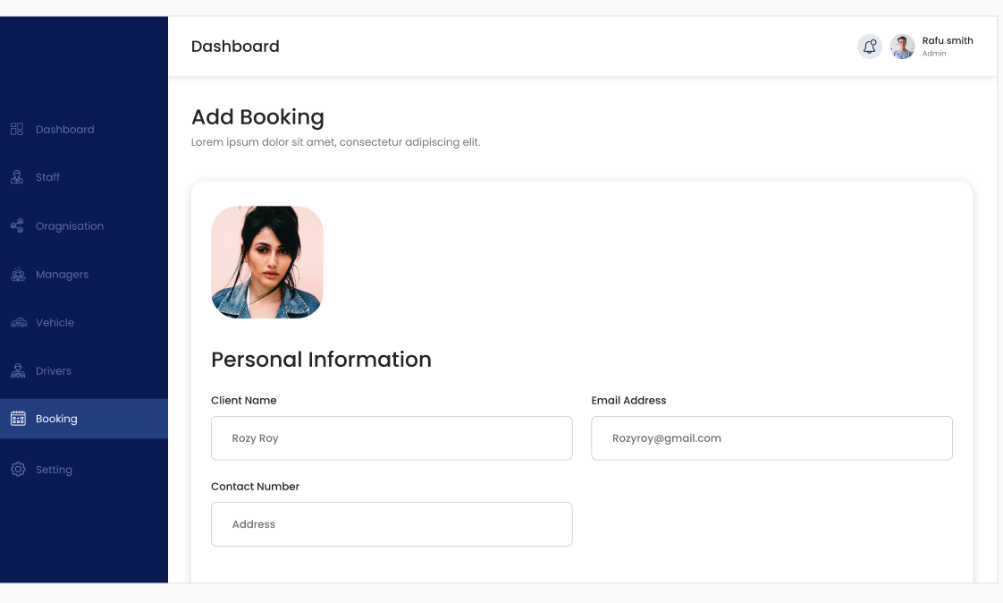
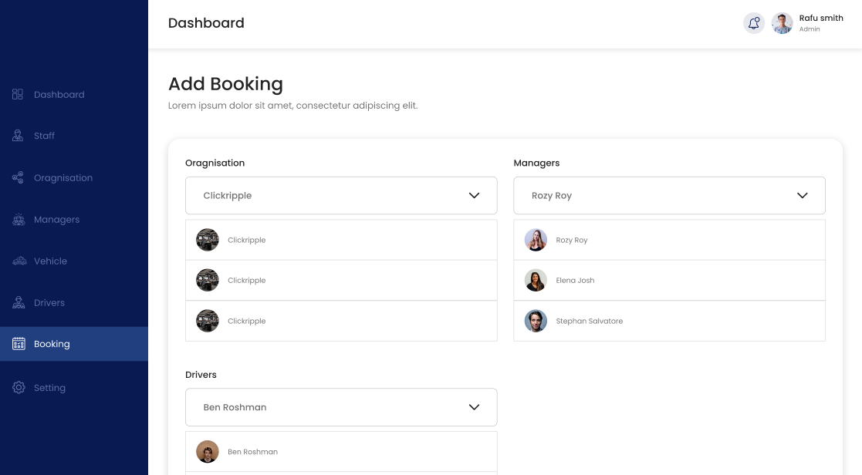
Don’t need two views for adding booking info and driver/vehicle info separately. Can all be on the same page.
Bookings will not have a separate Manager. Just Organisation, Driver and Vehicle.
Bookings may already have some comments attached, e.g. the Customer Comments which come with Booking.com reservations. We also need a separate field to add our own comments which drivers can see.

Slide 12
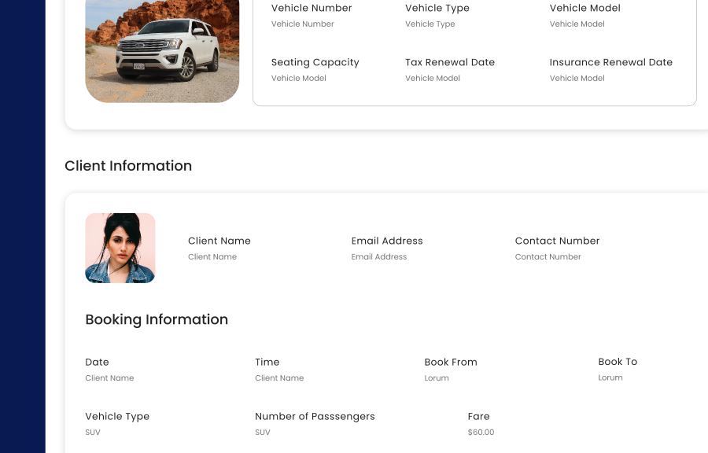
Dont need full driver and vehicle info. Just Driver display name, tel and vehicle registration plate.
Admins will need to be able to view a changelog for everything that has happened with this booking. Also need to be able to access all information which sent or received by API. This can be hidden behind a button or something.
This could also show the Event log, so the times and co-ordinates where the driver started ride, arrived at pick-up point, found customer and dropped off customer. This is visible to all including driver.

Slide 13
Drivers should be able to submit driver events through the booking information screen.
Somewhere at the top, there should be a button which says Start Ride.
When clicked, it changes the status and sends driver event to Booking.com if applicable.
Button then changes to ”At meeting point”, ”Passenger found” and ”Drop-off confirmed”.

