Slide 1




Business Overview
AN INTRODUCTION TO INCLOUD
NAME Title
in-cloud.ca
Notes:
NOTES
J’ai fait un test avec un capsule au lieu du cube
C’est un rough, la lumière sera retravaillé, mais le concept est là.
On pourra discuter pour voir si c’est une avenue intéressante pour vous.

Slide 2
Disclaimer

Slide 3
Communication Notice
Sagar TBD

Slide 4
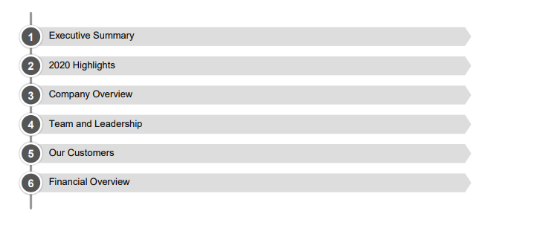
Table of Content
Sagar TBD

Slide 5
Executive Summary

Slide 6
Opportunity Overview
Sagar TBD

Slide 7
Opportunity Overview
Sagar TBD

Slide 8
Investment Highlights
Sagar TBD

Slide 9
Shareholder Motivation
Sagar TBD

Slide 10
Company Overview

Slide 11
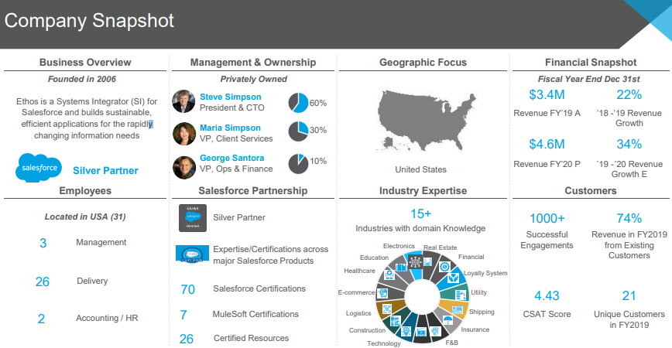
Company Snapshot
Details on the business
Salesforce Partnership
Pie Chart of Ownership
Customer Summary
Team
CEO and Execs

Slide 12


Industries Serviced
Simple slide explaining the industries they serve with logo and the industry name
If we have the detail, add what they do for that industry
Who We Are
What We Do
Who We Serve
Our Solutions

Slide 13
Business Model
Sagar TBD

Slide 14
SWOT Analysis
Strength and Weakness
Sagar
Opportunities and Threats
Ibrahim

Slide 15
Team

Slide 16







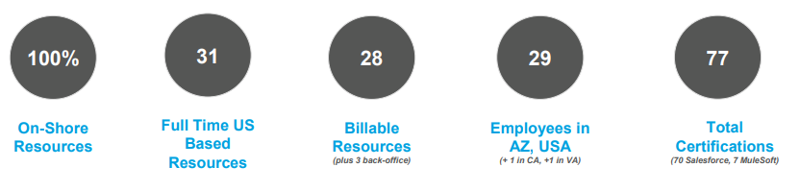
Team by the Numbers
Include a professional picture of Enzo
His experience and background
FINANCIAL SERVICES
Rising client expectations
Tedious access to data
Maintaining compliance
PROFESSIONAL SERVICES
Lack of visibility on project information
Tracking resource occupation rates
Keeping budgets in line
RETAIL
Understanding customer behavior
Too much data
Intense competitive landscape
HIGH TECH
Fast moving industry
Complex buyers
Siloed communications
HEALTH AND LIFE SCIENCES
Meeting patient expectations
Repetitive tasks and a busy schedule
Siloed systems
MANUFACTURING
Meeting commitments
Inaccurate forecasting
Inefficient processes
Notes:
NOTES
Réviser les icônes
Utiliser un visuel frontale avec les concepts
Chaque section supporte le visuel

Slide 17
CEO: Enzo Blasi
Include a professional picture of Enzo
His experience and background

Slide 18
Executive Team
Stephane Poirier
Eric Bourret
Brigitte Simard
Include a professional picture of the people
Their experience and background

Slide 19
Organization Structure
Convert Org Chart into a slide

Slide 20
Customers

Slide 21
Financial Overview

Slide 22






Fundamental Values That Drive Us
Our beliefs and the way we do things
Transparency
Build trust, promotes innovation and inspires us to go beyond your expectation.
Integrity
Our business partners are important to us and we team up with them to grow together.
Cohesion
We aim to provide a consistent level of engagement throughout the process to generate value for our clients.
Notes:
NOTES
Il y a trop de texte dans votre version…
1 seul texte serait suffisant, mais avec de l’impact, il ne faut pas que ça soit trop long
Les textes doivent être révisés
On pourrait utiliser un capsule de verre, similaire à la forme du “i” de cloud. Certains éléments graphique utilise déjà cette idée
Les images à l’intérieurs sont simple à titre indicatif, à revoir plus tard.

Slide 23







At a Glance
Incloud
Birth
Incloud Creation
100 +
Teammates
Increasing our
workforce
300+
Ressources
Local & nearshore resources
(UTC-5 - time zone)
70+
Certification
Getting Salesforce
Certifications
3X
Growth
Growth in the last 3 years
300+
Customers
Partnerships built on trust and collaboration
Notes:
NOTES
Je comprend la “courbe” que vous aviez mis pour symboliser la “croissance” et la “progression”
Cependant, je crois qu’une approche linéaire et contenant des dates serait plus simple tout en supportant la progression dans le temps
Le côté moderne est aussi bien présent. Simple et efficace
Je ne comprend pas le dernier point “verticals”. C’est quoi ça?

Slide 24









Salesforce Certifications
Include….
Notes:
Note:
Je crois que les badges ont été mis à jour et ne correspondent pas aux anciens termes. À revoir.

Slide 25


What We Do?
Enabling perpetual business performance with Salesforce technologies
01
Implement
Personalized Salesforce Implementation
02
Grow
Business Growth Booster
03
Perpetuate
Perpetual Business Performance
Notes:
NOTES
Version 3
Intégrer un élément de mouvement perpétuel
Pt intégrer dans la boite carré transparente ou capsule si le concept est retenu.

Slide 26







Supporting Companies at Every Stage
CUSTOMER SUCCESS
SALESFORCE SOLUTIONS
BUSINESS CONSULTING
DISCOVERY | INNOVATION | CONNECTION | PERSONALIZATION | IMPLEMENTATION | ADOPTION | IMPROVEMENT
We analyze your needs and objectives to propose a results-oriented strategy. | We develop an agile and structured plan to achieve your business transformation | We connect the data that is critical to your business success and make it actionable. | We develop innovative solutions for your specific needs, whatever your industry. | We integrate the software solutions into the existing structure of your company. | We work with your teams to ensure proper training and user adoption. | We offer our industry expertise to help you maintain your competitive edge and grow your business on an ongoing basis.
Notes:
NOTES
Remplacer les icônes
Uniformiser les textes pour l’espace occupé.

Slide 27

Who We Serve?
We serve financial services businesses, retail, HLS, professional services and construction, manufacturing, as well as high tech industries, providing tailored solutions to help them achieve their goals and optimize their operations.
01
Small
Personalized Salesforce Implementation
02
Medium
Business Growth Booster
03
Large
Perpetual Business Performance
Notes:
NOTES
Ajouter image de support dans la capsule

Slide 28













Financial Services
PARTNERSHIPS BUILT ON TRUST AND COLLABORATION

Slide 29


Success story
Desired Outcome
Shift the organizational culture from a conservative model to a digital-first approach.
Implement a Customer-Centric CRM Solution to drive this transformation.
Centralize, streamline, and optimize Sales, Service, and Marketing activities.
Drive revenue growth and expand market shares by maximizing revenue from existing and new customers.
Achieve cost reduction through efficient process streamlining and leveraging critical data points.
Incloud Solutions:
Revamp Sales and Marketing using the Challenger Sales Model.
Enhance Sales team productivity
with streamlined processes and automation.
Align Sales and Marketing, implement campaign automation.
National Bank Investments Inc. (NBI) is an investment fund management firm committed to manufacturing and distributing mutual funds, exchange-traded funds.
“Incloud, an amazing partner for our sales evolution thru innovative digital transformation.”
Annamaria Testani
Senior Vice-President, National Sales
Notes:
NOTES
Démontrer plus clairement l’alignement de chaque élément
Ajouter un visuel du concept de la boîte transparente
Réduire les titres, ajouter une définition brève du titre
L’alignement se fera plus tard, important d’avoir une quantité d’info similaire.

Slide 30


Success story
Project Vision and
Desired Results
Maximize engagement for subscribers and prospects.
Manage canceled/rescheduled appointments.
Implement a contest journey.
Launch a 1M-email Welcome Journey.
Incloud Solutions
Create segmentation (Data Extension).
Develop the customer journey.
Send personalized follow-up and rescheduling emails.
Send personalized benefits and contest emails.
Make modifications based on feedback.
Deploy the solution.
Monitor performance post-deployment.
Kaleido is a full stack SaaS platform that's hybrid enabled and designed to simplify the process of building and deploying private blockchain networks
Notes:
NOTES
Démontrer plus clairement l’alignement de chaque élément
Ajouter un visuel du concept de la boîte transparente
Réduire les titres, ajouter une définition brève du titre
L’alignement se fera plus tard, important d’avoir une quantité d’info similaire.

Slide 31







HEALTH AND LIFE SCIENCES
PARTNERSHIPS BUILT ON TRUST AND COLLABORATION

Slide 32
Success story
Challenges:
Inefficient external quoting process
Errors and client frustration due to quoting outside HubSpot
Project Vision and Desired Results
Migrate from HubSpot to Salesforce for seamless financial integration
Streamline proposal creation and billing through Salesforce Billing
Enhance solution sales and improve client delivery management
Implement PSA for efficient resource planning
Standardize project plans for consistency
Smile Digital Health platform streamlines healthcare data collection and provides the ability to share standardized, secure, and open information technologies powered by FHIR.
Incloud Solutions:
Replace HubSpot with Salesforce Sales Cloud
Implement CPQ for quoting
Integrate NetSuite with MuleSoft Composer for easy use
Standardize proposals
Centralize the approval process
Obtain a comprehensive corporate view of opportunities
Notes:
NOTES
Démontrer plus clairement l’alignement de chaque élément
Ajouter un visuel du concept de la boîte transparente
Réduire les titres, ajouter une définition brève du titre
L’alignement se fera plus tard, important d’avoir une quantité d’info similaire.

Slide 33











Retail
PARTNERSHIPS BUILT ON TRUST AND COLLABORATION

Slide 34
Success story
Challenges:
Lack of visibility on all communications
and touch points across all departments
Lack of utilization of the Salesforce instances to their full capabilities to generate ROI
Product increments plan for the entire
organization to align and act upon
Project Vision and Desired Results
Optimize customer journey mapping
Create a clear product roadmap
Expand Marketing Cloud for revenue growth
Enhance data-driven reporting
Empower team members with platform training
Incloud Solutions:
Define optimizations with customer journey mapping
Plan product increments with tasks, timeline, budget, and resources
Create additional journeys in Marketing Cloud for revenue and engagement
Enhance reporting for data-driven decision-making
Train team members for platform autonomy
A Canadian leader in the distribution of products, services and accessories for the health and well-being of pets of all kinds. The company with more than 65 stores across Quebec, as well as a major distribution centre.
Notes:
NOTES
Démontrer plus clairement l’alignement de chaque élément
Ajouter un visuel du concept de la boîte transparente
Réduire les titres, ajouter une définition brève du titre
L’alignement se fera plus tard, important d’avoir une quantité d’info similaire.

Slide 35

Success story
Project Vision & Desired Outcome
Enhance and set up improved email journeys in Marketing Cloud.
Facilitate smooth onboarding to maximize effective team utilization of Marketing Cloud.
Explore opportunities to fully maximize the capabilities of Marketing Cloud for increased efficiency.
Generate and seamlessly implement campaign ideas in Marketing Cloud for optimized marketing efforts.
Optimize Commerce Cloud for improved performance and alignment with Marketing Cloud.
Re-engage inactive prospects through targeted email campaigns to boost overall revenue.
Increase Customer Lifetime Value (CLV) by leveraging ecommerce and email marketing, reducing entry barriers.
Conduct a concise audit of marketing data usage, providing actionable recommendations for improvements.
Incloud Solutions
Set up and streamline email journeys in Marketing Cloud, addressing and fixing any issues.
Facilitate the onboarding process for Marketing Cloud, ensuring a seamless start for the team.
Provide comprehensive training and support to exploit the full potential of Marketing Cloud.
Collaborate on generating campaign ideas and implement them effectively within Marketing Cloud.
Optimize Commerce Cloud for better integration and synergy with Marketing Cloud.
Develop and execute re-engagement campaigns targeting inactive prospects, leading to increased email marketing revenue.
Implement strategies within Marketing Cloud to boost CLV, focusing on reducing barriers to entry in ecommerce.
Conduct a detailed audit of marketing data usage, offering recommendations for improvements to enhance overall efficiency.
DavidsTea is a publicly traded Canadian specialty tea and tea accessory retailer based in Montreal, Quebec.
Notes:
NOTES
Démontrer plus clairement l’alignement de chaque élément
Ajouter un visuel du concept de la boîte transparente
Réduire les titres, ajouter une définition brève du titre
L’alignement se fera plus tard, important d’avoir une quantité d’info similaire.

Slide 36



Thank You
Name here, Title
your name here@in-cloud.ca
in-cloud.ca
© 2023 Incloud Business Solutions. All Rights Reserved
Notes:
NOTES
Me fournir une photo d’équipe
Voir la mosaïque pour les photos d’employé(e)s

